Slide 1
EUI-innovative actions call 3
Topic “Energy transition”
Applicant seminar
23 May 2024

Slide 2
Cohesion policy 2021-27
Unprecedented support to achieve EU energy goals
Cohesion policy programmes
2021-2027
SUD
Strategies
EUI-IA
Call 3
EUR 110 billion of cohesion policy funding to support the transition
EUR 12.4 billion via sustainable urban development (SUD) strategies
EUI-innovative actions Call 3
Make the right connections to support your project ideas on the « energy transition » topic!
#EURegioDataStories – Exploring investments 2021-2027

Slide 3
EUI-INNOVATIVE ACTIONS CALL 3
Testing new solutions led by cities to accelerate the energy transition to a climate-neutral EU
Prompts for urban authorities:
Minimizing the energy demand in cities via:
buildings’ retrofitting and other measures/incentives with a focus on addressing energy poverty and/or deprived neighbourhoods
the decarbonisation of urban public transports and shift to active mobility modes, including within functional urban areas;
Diversifying local energy sources by boosting the production of renewable energies and/or the use of secondary energy sources, including waste within a spirit of full circularity and resources efficiency;
Deploying smart and integrated local energy systems by fostering innovative approaches to energy storage and supply, integrated energy systems across sectors (incl. transport) or by expanding the model of Positive Energy Districts;

Slide 4
EUI-INNOVATIVE ACTIONS CALL 3
Testing new solutions led by cities to accelerate the energy transition to a climate-neutral EU
Prompts for urban authorities:
Maximizing multi-stakeholder and citizens’ engagement by developing incentives and/or innovative supporting schemes and/or business models to develop energy communities and/or to accelerate co-participation and/or behaviour changes (including via digital solutions);
Boosting jobs and skills for the energy transition by identifying local labour market shortages of qualified staff in energy sectors and/or exploring the potential for new recycled products, jobs and/or businesses that a just energy transition could enable (e.g. proximity services, micro-entreprises).
Prompts are indicative
Combination is welcomed (integrated projects)
EUI-IA strategic assessment criteria also matter

Slide 5
EUI-INNOVATIVE ACTIONS CALL 3
Testing new solutions led by cities to accelerate the energy transition to a climate-neutral EU
Link your proposal with a Call 3 « Cohesion policy target »
Specific objective 2.1 “promoting energy efficiency and reducing greenhouse gas emissions”,
Specific objective 2.2 “promoting renewable energy”;
Specific objective 2.3 “developing smart energy systems, grids and storage outside the Trans-European Energy Network (TEN-E)”;
Specific objective 2.6 “promoting the transition to a circular and resource efficient economy”;
Specific objective 2.8 “promoting sustainable multimodal urban mobility, as part of transition to a net zero carbon economy”;
Specific objective 5.1 “fostering the integrated and inclusive social, economic and environmental development, culture, natural heritage, sustainable tourism and security in urban areas”.
References: ERDF Regulation – Article 3
Be specific:
‘Our project is relevant to SO 2.1 as it will promote energy efficiency’
‘Our project will contribute to achieve SO 2.1 goals/complement measures on energy efficiency in the ERDF programme [title/reference] by [explanations]’
Link to relevant strategies/plans (scale-up/EU added value):
. National Energy and Climate Plans
. Sustainable Energy and Climate Action Plans
. Sustainable Urban Development Strategies
. Sustainable Urban Mobility Plans
. Climate City Contracts

Slide 6
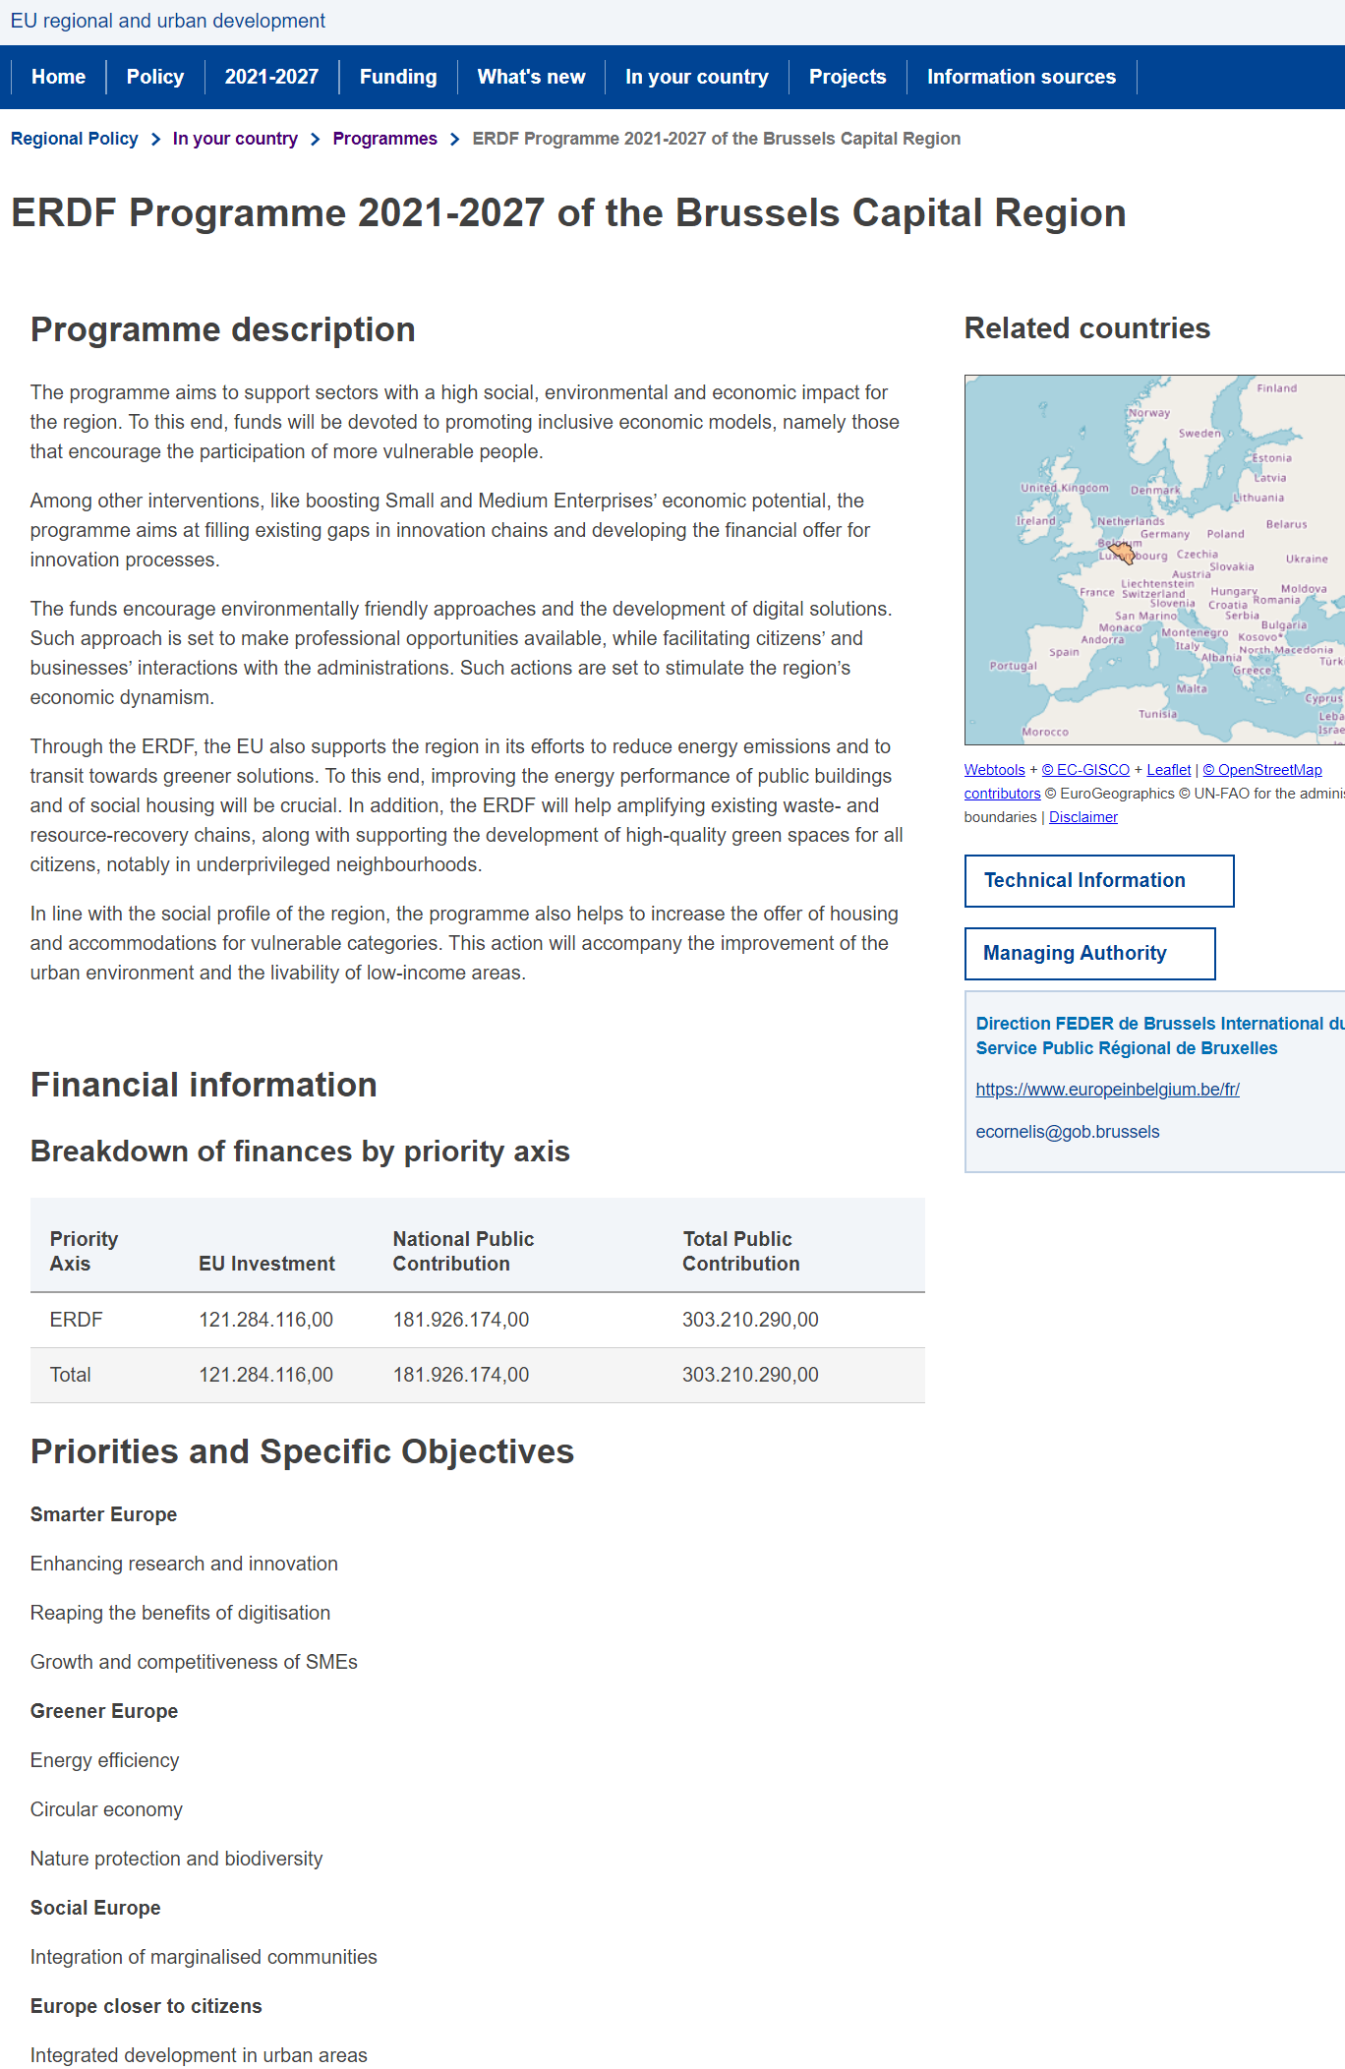
EUI-INNOVATIVE ACTIONS CALL 3
Testing new solutions led by cities to accelerate the energy transition to a climate-neutral EU
Information on Cohesion policy in your country?
National single portals: National single portals - European Commission (europa.eu)
Inforegio – summary of programmes:
Inforegio - Programmes (europa.eu)
Example: Brussels Capital Region ERDF programme 2021-27

Slide 7
EUI-INNOVATIVE ACTIONS CALL 3
Testing new solutions led by cities to accelerate the energy transition to a climate-neutral EU
A list of indicators inspired from Cohesion policy to capture some of the expected co-benefits of the energy transition
Output indicators (examples):
People supported (trained, upskilled, accompanied or assisted); (measurement unit: persons)
New products and services created (measurement unit: new products/services)
Public buildings with improved energy performance (measurement unit: square meters).
Result indicators (exemples):
Jobs created in supported entities (measurement unit: annual FTEs)
Total renewable energy produced (of which, e.g. electricity, thermal) (measurement unit: MWh/year).
Users connected to smart energy systems (measurement unit: end users/year)
…NOT binding but to be used when relevant to complete your project proposals’ specific indicators

Slide 8
‘Energy transition’ Examples of relevant information sources
Urban Innovative Actions 2014-2020 with focus on the energy transition, circular economy, urban poverty and/or housing
https://www.uia-initiative.eu/en/uia-cities
Urban agenda partnership for the EU on energy transition
https://www.urbanagenda.urban-initiative.eu/partnerships/energy-transition
Ninth report on economic, social and territorial cohesion
Inforegio - Eighth Report on Economic, Social and Territorial Cohesion (europa.eu)
H2020 Lighthouse Projects programme
https://smart-cities-marketplace.ec.europa.eu/projects-and-sites/projects?f%5B0%5D=project_type%3Alighthouse
Energy communities – Citizen-driven energy actions
Energy communities (europa.eu)
Communication REPowerEU Plan (COM(2022)230 final)
Key documents: REPowerEU - European Commission (europa.eu)
EU Strategy for Energy System Integration (COM(2020)299 final)
COM 2020 EU Strategy for Energy system integration.pdf (cec.eu.int)
100 climate-neutral and smart cities – info kit for cities
Citiesmissionguied.pdf (cec.eu.int)
JPI Urban Europe – Positive Energy District (PED)
Positive Energy Districts (PED) | JPI Urban Europe (jpi-urbaneurope.eu)

Slide 9
Thank you for your attention!
More information at:
Energy transition | EUI (urban-initiative.eu)

