Slide 2
EUI PEER REVIEW N° 6
04-05 DECEMBER 2024 BASSO PIAVE
Welcome to Basso Piave
Mayor of Jesolo – Christofer De Zotti
Mayor of San Donà di Piave - Alberto Teso

Slide 3
EUI PEER REVIEW N° 6
04-05 DECEMBER 2024 BASSO PIAVE
European Commission
Carlotta Cesco Gaspere– DG REGIO

Slide 4
Sustainable Urban Development of Cohesion Policy 2021-2027
EUI, Italy, 4 December 2024
Carlotta CESCO GASPERE, REGIO.03
Inclusive Growth, Urban and Territorial Development

Slide 5





Cohesion Policy Framework 2021-2027
PO1- A smarter Europe
PO2 - A greener, low-carbon Europe
PO3 - A more connected Europe
PO4 - A more social Europe
PO5 - A Europe closer to citizens by fostering sustainable and integrated territorial development
SO 5.1 fostering the integrated and inclusive development in urban areas
SO 5.2 fostering the integrated and inclusive development in areas other than urban

Slide 6
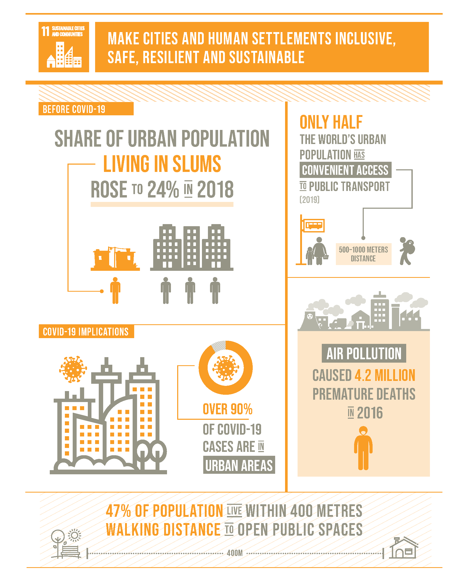
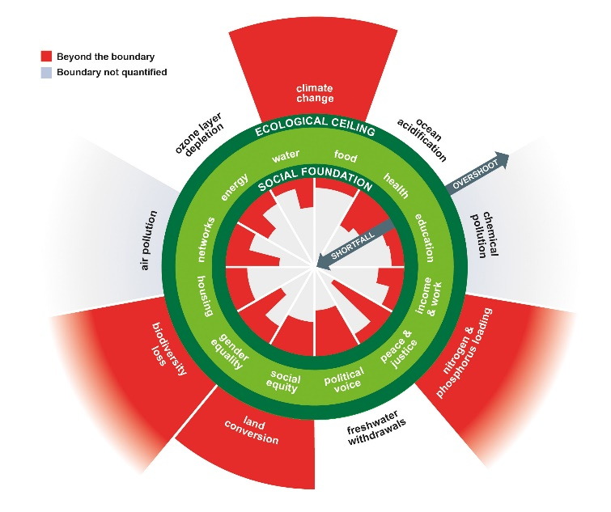
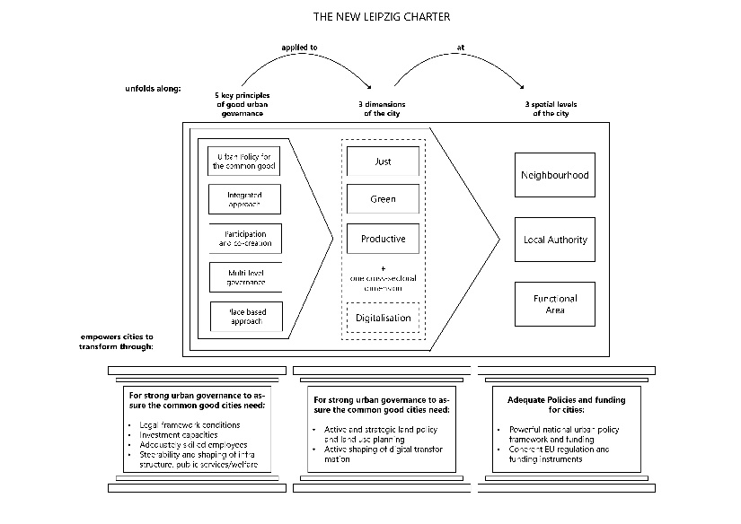
ERDF ART 11: SUSTAINABLE URBAN DEVELOPMENT
To more effectively tackle the economic, environmental, climate, demographic and social challenges affecting urban areas, with specific attention to green and digital transition and functional urban areas ERDF supports Sustainable Urban Development based on Integrated territorial development strategies focused on urban areas
SUD:
  All investments under PO5 specific objective 1 (per definition for strategies targeting urban areas)
  All investments under PO1-4 when in territorial tools targeting urban areas
Minimum 8% of ERDF at national level> SUD

Slide 7





The minimum requirements (art. 29 Reg. 2021/1060)
Territorial or local strategies
Under the responsibility of relevant territorial authorities or bodies
Definition of the targeted area
according to development needs and potentials
Project selection
Relevant territorial bodies involved in project selection
Integrated approach
Locally coordinated interventions
multi-sectoral, multi-stakeholder, multi-level governance
Functional area approach
Participatory
Partnership
With involvement of stakeholders in the preparation and implementation

Slide 8
Sustainable Urban Development (SUD) in 2021-2027 by MS
Commitments in national and regional programmes fulfil or exceed the 8% target set for sustainable urban development support under ERDF
EUR 24.4 billion (almost 12% of Member States ERDF allocation)
Additional EUR 4 billion for SUD from ESF+, CF, JTF, Interreg

Slide 9
Sustainable Urban Development (SUD) in 2021-2027 by MS and Funds
DE, EL, LT, PL and RO decided to allocate funds to SUD strategies from 3 different sources: ERDF, ESF+, JTF or CF.
CZ, FR, IT, PT, SK decided to support the implementation of SUD strategies from 2 funds: CZ and SK :ERDF and CF or JTF: FR, IT, PT: ERDF and ESF+.

Slide 10
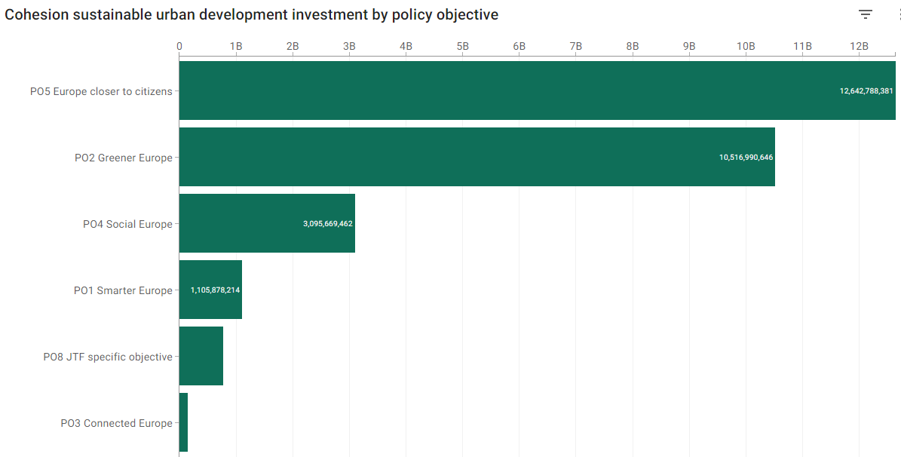
Sustainable Urban Development (SUD) in 2021-2027 by PO
Highest share of SUD with EUR 12.6 billion (almost 45% of total amount) is allocated under novel policy objective (PO) 5 ‘Europe Closer to Citizens’ privileging place-based territorial approaches
SUD is found in all policy objectives – PO2 ‘Greener Europe’ is second biggest contributor to SUD with share of EUR 10.5 billion (more than 37% of total amount) while also PO4 Social Europe contribution of EUR 3.1 billion (close to 11%) is not insignificant, confirming centrality of green transition and addressing social inequalities for urban development

Slide 11
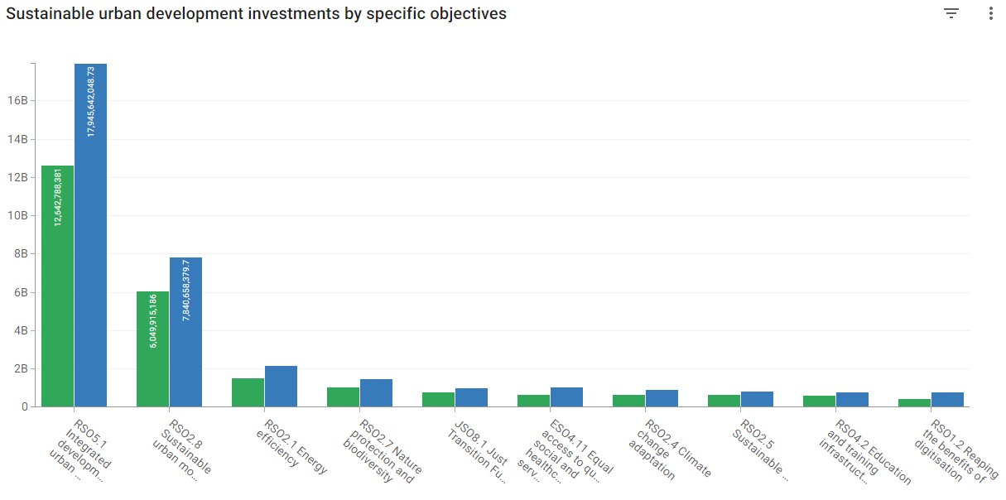
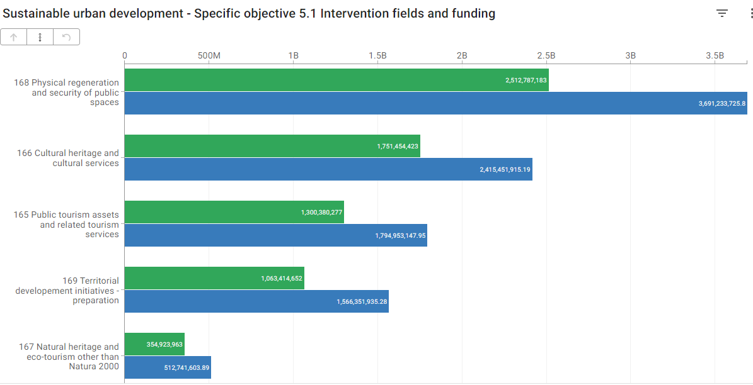
What do we finance in SUD in 2021-2027?

Slide 12
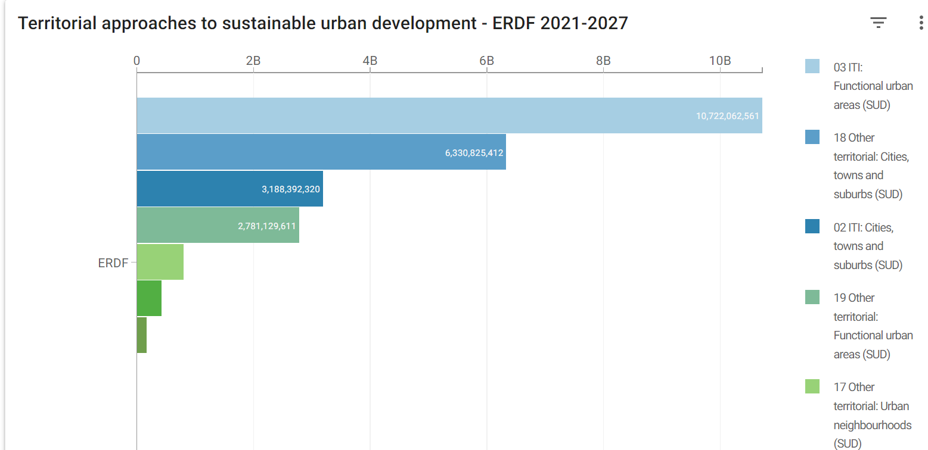
Territorial focus: where do we finance SUD?
More than half of planned sustainable urban development funds under PO5 are allocated to Functional Urban Areas
Functional Urban Areas are instrumental for tackling urban-rural linkages

Slide 13
SUD allocation in Veneto (Italy)
Row Labels | Sum of EU Amount
Veneto - ERDF | 77,106,000
03 ITI: Functional urban areas (SUD) | 66,706,000
RSO2.8 Sustainable urban mobility | 23,300,000
RSO4.3 Integration of marginalised communities | 16,000,000
RSO2.7 Nature protection and biodiversity | 13,006,000
RSO5.1 Integrated development in urban areas | 10,000,000
RSO1.2 Reaping the benefits of digitisation | 3,200,000
RSO1.3 Growth and competitiveness of SMEs | 1,200,000
07 ITI: Sparsely populated areas | 10,400,000
RSO1.3 Growth and competitiveness of SMEs | 4,400,000
RSO5.2 Integrated development in rural and coastal areas | 3,200,000
RSO2.2 Renewable energy | 2,800,000
Veneto - ESF+ | 3,266,448
03 ITI: Functional urban areas (SUD) | 2,466,448
ESO4.11 Equal access to quality social and healthcare services | 2,466,448
31 Other approaches: Sparsely populated areas | 800,000
ESO4.6 Quality and inclusive education and training systems | 800,000
Grand Total | 80,372,448
There are 2 regional Programmes funding ITIs in Veneto Region: ERDF and ESF+. The use of ITI allows to finance also from SO4.11.
The ERDF programme allows for ITIs funding from 6 Specific Objectives and 4 Policy objectives.

Slide 14
SUD allocation in Croatia
Only the ERDF supports the implementation of the SUD strategies.
The ITIs in HR allow funding from 3 different SOs and priorities.
Sum of EU Amount | Column Labels
Row Labels | ERDF | Grand Total
Integrated territorial programme – HR – ERDF/JTF | 681,275,213 | 681,275,213
03 ITI: Functional urban areas (SUD) | 681,275,213 | 681,275,213
RSO1.3 Growth and competitiveness of SMEs | 30,000,000 | 30,000,000
RSO2.8 Sustainable urban mobility | 141,600,000 | 141,600,000
RSO5.1 Integrated development in urban areas | 509,675,213 | 509,675,213
Grand Total | 681,275,213 | 681,275,213

Slide 15
SUD allocation in Czech Republic
SUD is funded through 5 Programmes in CZ.
The major complexity is the fact that there are several programmes with different MAs that should coordinate the calls (especially for integrated projects of the FUA).
Sum of EU Amount | Column Labels
Row Labels | CF | ERDF | Grand Total
Competitiveness Programme - CZ - ERDF |  | 61,005,800 | 61,005,800
03 ITI: Functional urban areas (SUD) |  | 61,005,800 | 61,005,800
RSO1.1 Enhancing research and innovation |  | 61,005,800 | 61,005,800
Environment - CZ - ERDF/CF | 55,327,413 | 32,863,039 | 88,190,452
03 ITI: Functional urban areas (SUD) | 55,327,413 | 32,863,039 | 88,190,452
RSO2.1 Energy efficiency |  | 20,363,039 | 20,363,039
RSO2.2 Renewable energy | 2,867,893 |  | 2,867,893
RSO2.4 Climate change adaptation | 38,890,501 | 12,500,000 | 51,390,501
RSO2.6 Circular economy | 13,569,019 |  | 13,569,019
Integrated Regional Programme - CZ - ERDF |  | 996,010,196 | 996,010,196
03 ITI: Functional urban areas (SUD) |  | 996,010,196 | 996,010,196
RSO1.2 Reaping the benefits of digitisation |  | 4,744,264 | 4,744,264
RSO2.7 Nature protection and biodiversity |  | 185,374,677 | 185,374,677
RSO2.8 Sustainable urban mobility |  | 358,705,929 | 358,705,929
RSO4.2 Education and training infrastructure |  | 192,147,088 | 192,147,088
RSO4.3 Integration of marginalised communities |  | 78,562,603 | 78,562,603
RSO4.6 Culture and sustainable tourism |  | 176,475,634 | 176,475,634
Johannes Amos Comenius - CZ - ERDF/ESF+ |  | 65,697,962 | 65,697,962
03 ITI: Functional urban areas (SUD) |  | 65,697,962 | 65,697,962
RSO1.1 Enhancing research and innovation |  | 65,697,962 | 65,697,962
Transport - CZ- ERDF/CF | 931,816,869 |  | 931,816,869
03 ITI: Functional urban areas (SUD) | 931,816,869 |  | 931,816,869
RSO2.8 Sustainable urban mobility | 851,816,869 |  | 851,816,869
RSO3.2 Sustainable transport | 80,000,000 |  | 80,000,000
Grand Total | 987,144,282 | 1,155,576,997 | 2,142,721,279

Slide 16

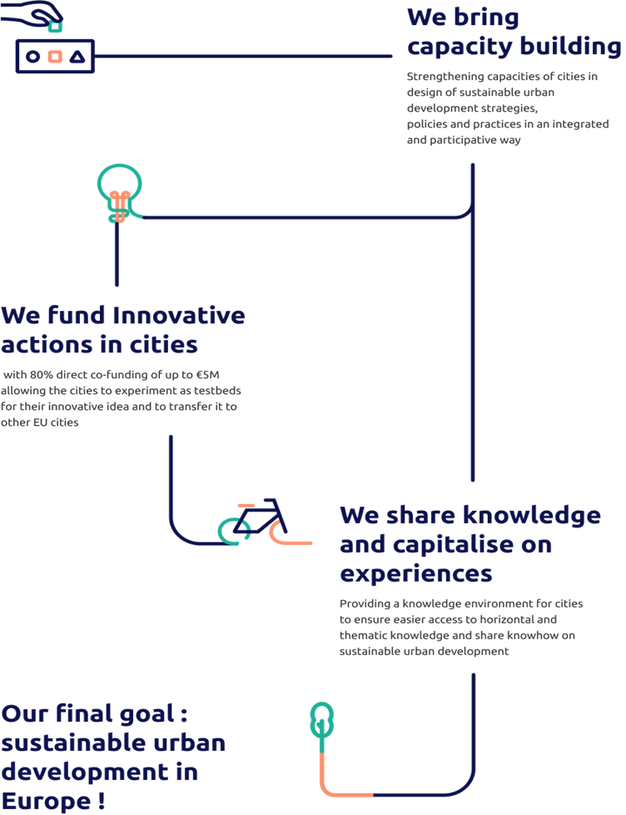
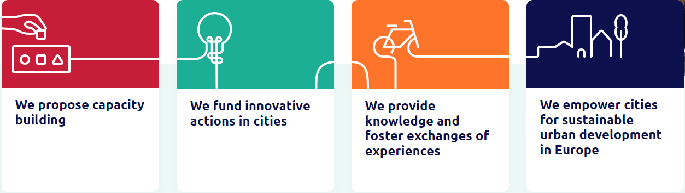
Given key role of cities on delivering on EU challenges and policies, Cohesion policy support to sustainable urban development was reinforced for the 2021-2027 period also with establishment of a novel European Urban Initiative (EUI).
With a budget of EUR 395 million, EUI supports cities of all sizes to build capacity and knowledge, to support innovation and develop transferable and scalable solutions to urban challenges of EU relevance. EUI has a total ERDF budget of EUR 395 million for 2021-2027.*
* Reduction of EUR 55 million following MFF review
European Urban Initiative | EUI (urban-initiative.eu)
Portico, EUI knowledge platform

Slide 17
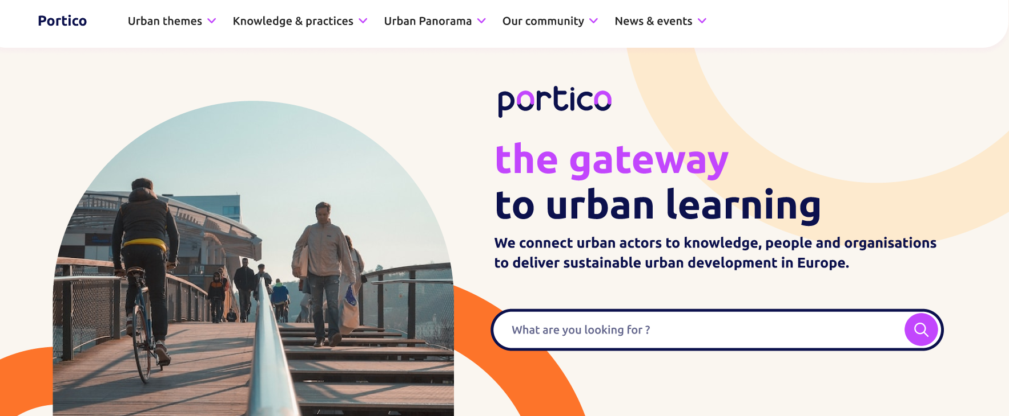
Aimed at European urban community to access knowledge and skills needed to design and implement sustainable urban policies and strategies and to connect with peers

Slide 18


Portico, EU platform on Sustainable Urban Development (urban-initiative.eu)

Slide 19
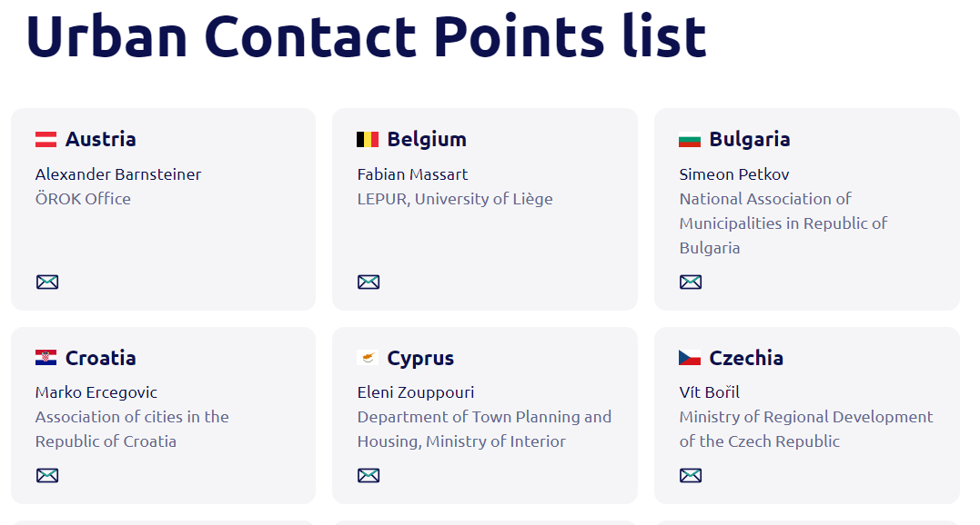
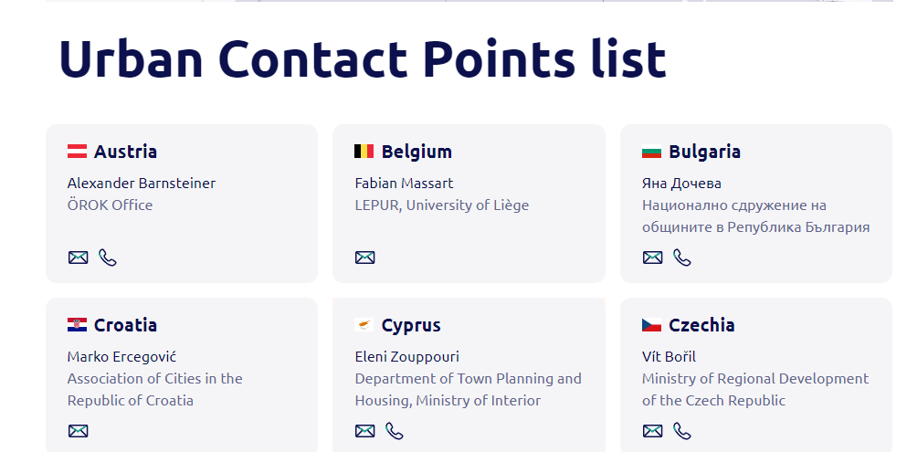
Dedicated page with list and contacts on EUI website : Urban Contact Points | EUI (urban-initiative.eu)

Slide 20
Thank you for your attention
For more information and updates:
Sustainable Urban development 2021-2027 | Data | European Structural and Investment Funds (europa.eu)
European Urban Initiative | EUI (urban-initiative.eu)
Functionalareas.eu

Slide 21
EUI PEER REVIEW N° 6
04-05 DECEMBER 2024 BASSO PIAVE
Welcome to the EUI Peer Review
EUI Permanent Secretariat – Magdalena Baidan

Slide 22
SUD in Italy
Moderated by
Martina Pertoldi EUI Expert

Slide 23
EUI PEER REVIEW N° 6
04-05 DECEMBER 2024 BASSO PIAVE
Sustainable Urban Development in the Veneto Region
Managing Authority, Office of Sustainable Urban Development, Veneto Region - Andrea Massarolli

Slide 24


Area Politiche Economiche, Capitale Umano e Programmazione Comunitaria
Direzione Programmazione Unitaria
ERDF Veneto region Programme 2021-2027
Sustainable urban development Integrated Strategies (SUDIS)
Andrea Massarolli
Direzione Programmazione Unitaria, Autorità di Gestione FESR,
Ufficio Sviluppo Urbano Sostenibile, Veneto Region
4^{h} December 2024 - Jesolo

Slide 25


The procedure to select the Urban Areas
Regional executive procedures
(DGRV 1832/2021
DGRV 680/2022
DDRV 86/2022)
In 2021 Veneto Region opened a call to identify 11 Functional Urban areas, composed of a coalition of municipalities (min. 6 max 11 municipalities, according to selected demographic and geographic criteria)
Sustainable Urban Development (SUD) involves a total of 125 municipalities and approximately 2.5 million inhabitants (almost half of the Veneto’s population) within the 11 functional urban areas.
For each Area, a Strategy (“SUDIS”) was approved.
Each Area has an Urban Authority (UA) as institutional leader of the coalition.
TERRITORY AND CITIZENS INVOLVED
Notes:
Aree Urbane della programmazione 2014-2020: 34 Comuni
SPECIFICARE CHI è AU
VERONA: 3 Comuni - Verona, San Giovanni Lupatoto, Buttapietra
PADOVA: 3 Comuni - Padova, Maserà di Padova e Albignasego
VENEZIA: 6 Comuni - Venezia, Marcon, Mirano, Quarto d’Altino, Salzano e Spinea
VICENZA: 6 Comuni - Vicenza, Altavilla Vicentina, Caldogno, Creazzo, Sovizzo, Torri di Quartesolo
TREVISO: 6 Comuni -Treviso, Silea, Casier, Paese, Villorba e Preganziol
MONTEBELLUNA: 10 Comuni - Montebelluna, Castelfranco Veneto, Altivole, Asolo, Caerano di San Marco, Istrana, Maser, Riese Pio X°, Trevignano, Vedelago
Aree della programmazione 2021-2027: 125 Comuni
Verona: 10 Comuni – VERONA, BUSSOLENGO, CASTEL D'AZZANO, PESCANTINA, SAN GIOVANNI LUPATOTO, SAN MARTINO BUON ALBERGO, SAN PIETRO IN CARIANO, SOMMACAMPAGNA, SONA, VILLAFRANCA DI VERONA
Padova: 9 Comuni – PADOVA, ABANO TERME, ALBIGNASEGO, MASERÀ DI PADOVA, NOVENTA PADOVANA, PONTE SAN NICOLÒ, RUBANO, SELVAZZANO DENTRO, VIGONZA
Venezia: 13 Comuni – VENEZIA, CAMPAGNA LUPIA, CAMPOLONGO MAGGIORE, CHIOGGIA, FOSSÒ, MARTELLAGO, MIRA, MIRANO, PIANIGA, SALZANO, SANTA MARIA DI SALA, SCORZÈ, SPINEA
Vicenza: 9 Comuni – VICENZA, ALTAVILLA VICENTINA, CALDOGNO, COSTABISSARA, CREAZZO, LONGARE, QUINTO VICENTINO, SOVIZZO, TORRI DI QUARTESOLO
Treviso: 9 Comuni – TREVISO, CARBONERA, CASIER, PAESE, PONZANO VENETO, PREGANZIOL, QUINTO DI TREVISO, SILEA, VILLORBA,
Asolano-Castellana-Montebellunese: 13 Comuni – MONTEBELLUNA, ALTIVOLE, ASOLO, CAERANO SAN MARCO, CASTELFRANCO VENETO, FONTE, ISTRANA, LORIA, MASER, ,RIESE PIO X, TREVIGNANO, VEDELAGO, VOLPAGO DEL MONTELLO
Belluno: 12 Comuni – BELLUNO; BORGO VALBELLUNA, CESIOMAGGIORE, FELTRE, FONZASO, LIMANA, PEDAVENA, PONTE NELLE ALPI, SAN GREGORIO NELLE ALPI, SANTA GIUSTINA, SEDICO, SOSPIROLO
Rovigo: 13 Comuni – ROVIGO, ADRIA, ARQUÀ POLESINE, BADIA POLESINE, BOSARO, CEREGNANO, COSTA DI ROVIGO, LENDINARA, LUSIA, SAN MARTINO Di VENEZZE, PONTECCHIO POLESINE, VILLADOSE, VILLANOVA DEL GHEBBO
Coneglianese-Vittoriese: 13 Comuni – CONEGLIANO, CODOGNÈ, COLLE UMBERTO, GODEGA DI SANT’URBANO, PIEVE DI SOLIGO, REFRONTOLO, SAN FIOR, SAN PIETRO DI FELETTO, SAN VENDEMIANO, SANTA LUCIA DI PIAVE, SUSEGANA, TARZO, VITTORIO VENETO
Pedemontana: 13 Comuni – BASSANO DEL GRAPPA, BREGANZE, CASSOLA, COLCERESA, MALO, MAROSTICA, MUSSOLENTE, ROSÀ, SARCEDO, SCHIO, THIENE, SAN VITO DI LEGUZZANO, VALDAGNO
Basso Piave Urbano: 11 Comuni – SAN DONÀ DI PIAVE, CAVALLINO TREPORTI, CEGGIA, ERACLEA, FOSSALTA DI PIAVE, JESOLO, MEOLO, MUSILE DI PIAVE, NOVENTA DI PIAVE, QUARTO D'ALTINO, TORRE DI MOSTO

Slide 26
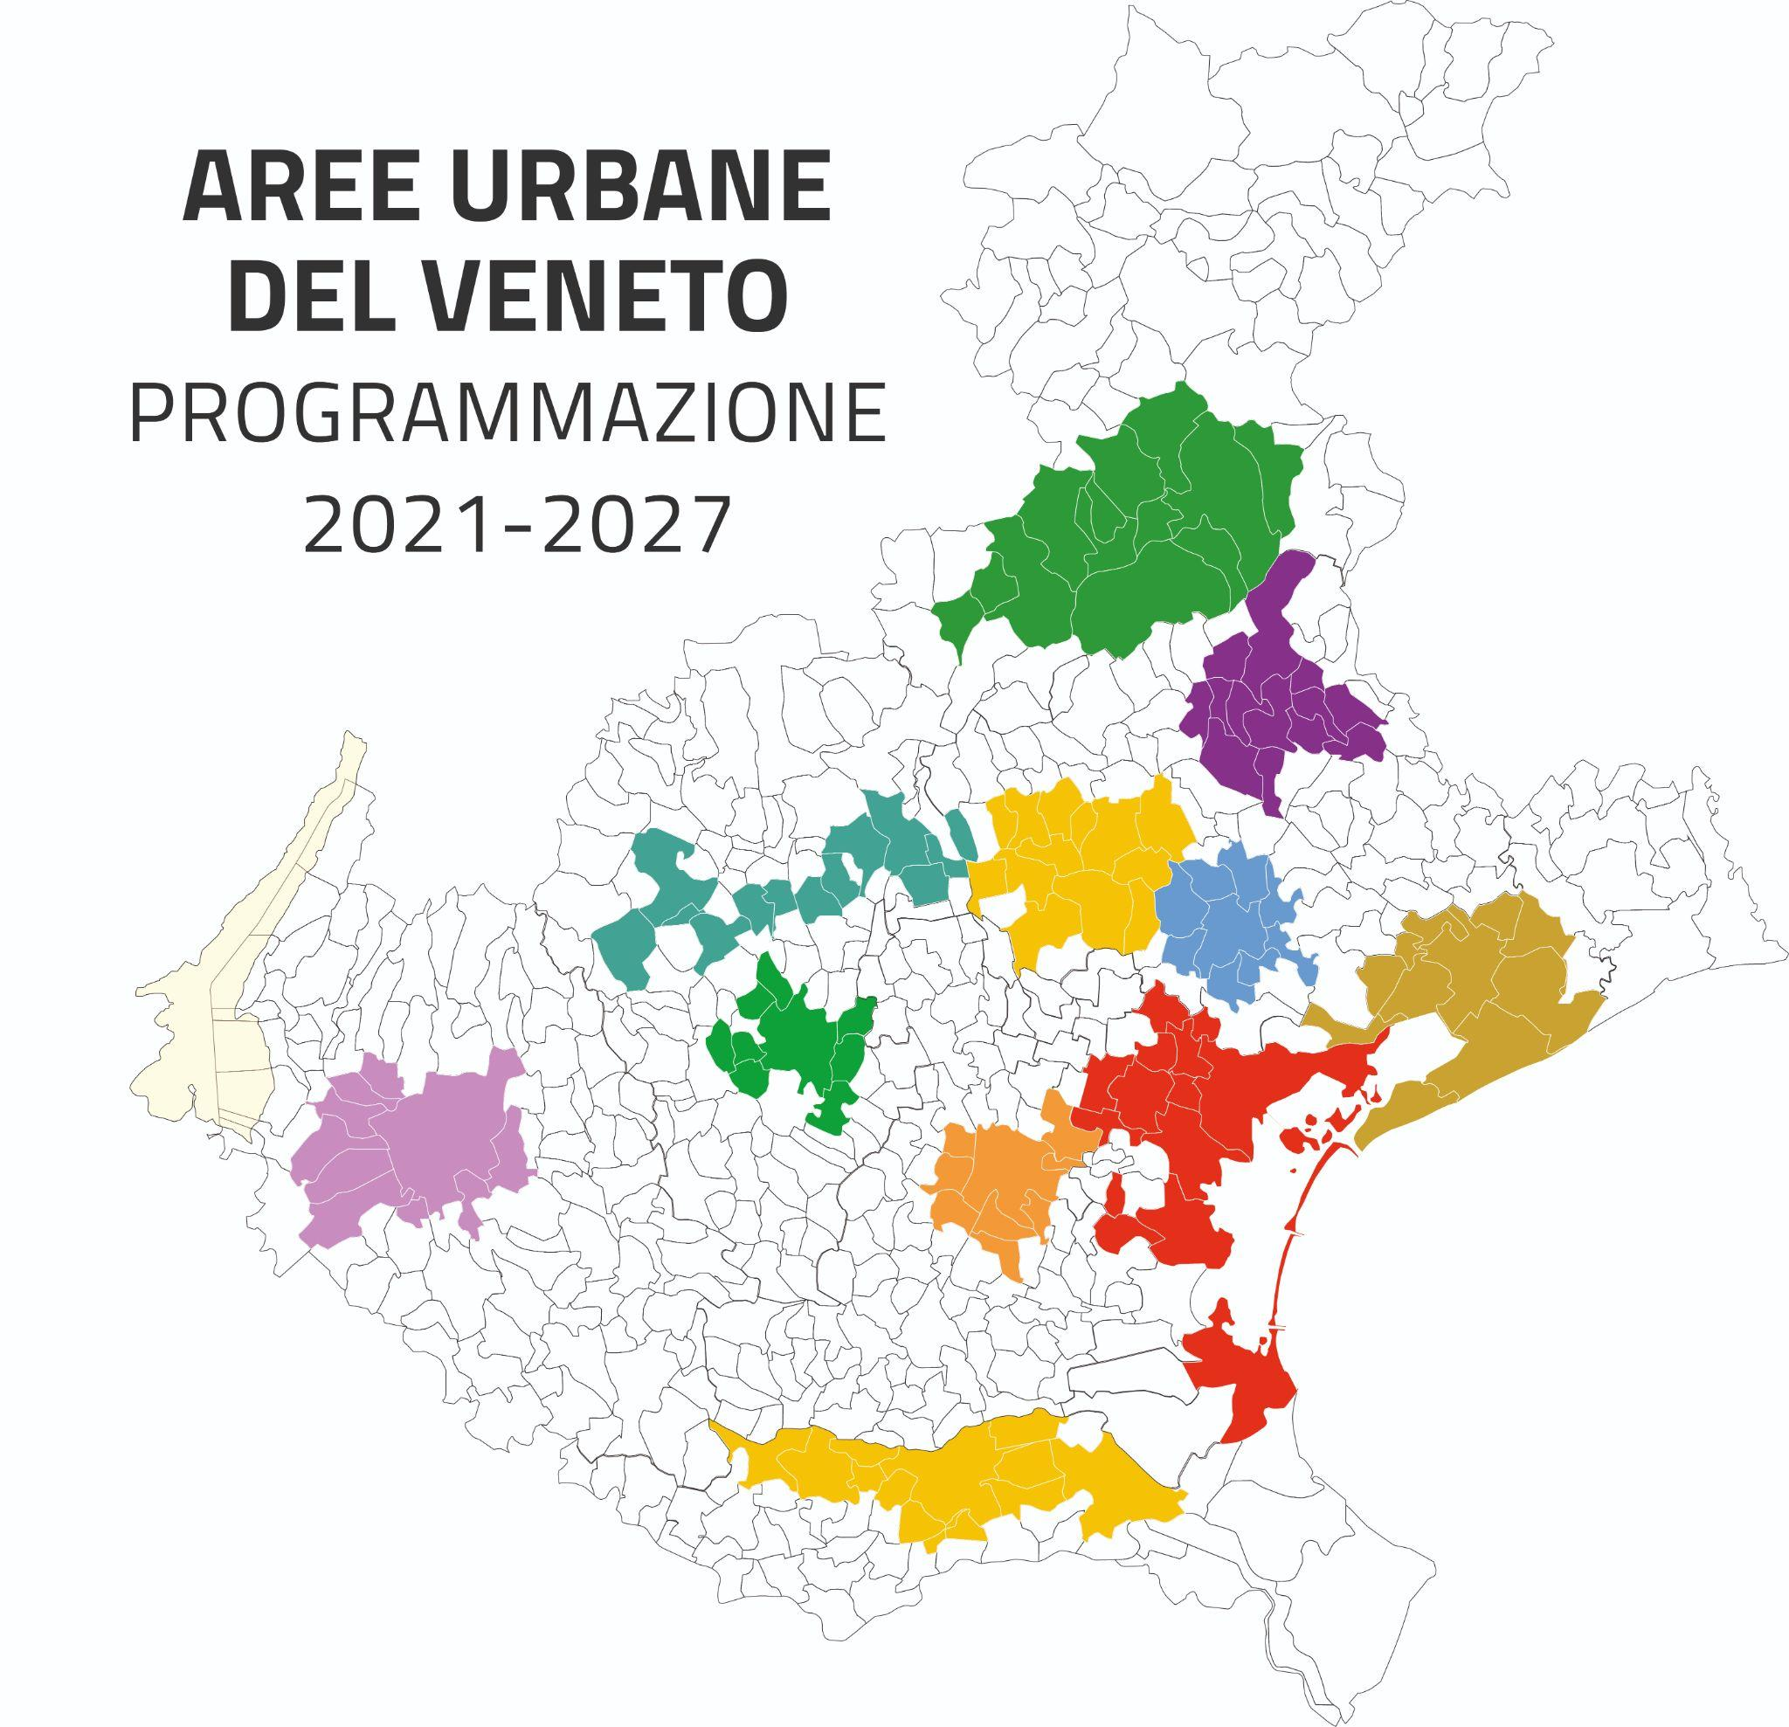
The 11 Functional urban areas
ASOLANO-CASTELLANA-MONTEBELLUNESE
13 Cities , AU Montebelluna
PADOVA, 9 Cities, UA Padova
TREVISO, 9 Cities, UA Treviso
VICENZA, 9 Cities, UA Vicenza
VERONA, 10 Cities, UA Verona
VENEZIA, 13 Cities, UA Venezia
BELLUNO,12 Cities, UA Belluno
ROVIGO, 13 Cities, UA Rovigo
BASSO PIAVE URBANO, 11 Cities, UA San Donà di Piave
CONEGLIANESE-VITTORIESE, 13 Cities, UA Conegliano
PEDEMONTANA, 13 Cities, UA Bassano del Grappa
VENETO FUNCTIONAL
URBAN AREAS
2021-2027
Urban areas confirmed by the 2014-2020 period
new areas in the current programming 2021-2027
The reasons that led to the extension:
request of the stakeholders and partners of the territory following the positive experience of 2014-2020 period
involvement of all the 7 Provincial seats of Veneto Region
extension to areas whose lead city is not a provincial seat, but still represent a point of reference for the neighbouring municipalities, according to regional planning

Slide 27
Governance of the Urban Areas
Relations between Municipalities composing the coalition of the Urban Area
An Agreement between the Municipalities of the Urban Area regulates the methods and tools for coordinating all member municipalities;
The lead municipality is appointed to hold the role of “Urban Authority” (UA)
Establishment of an Urban Partnership Table for the involvement of local actors.

Slide 28

Criteria for the distribution of financial resources to Urban areas
50 %
EUR 86.47 million
equal share for each Urban Area
FIXED
AMOUNT
EUR 86.47 million
equal share for each Urban Area
FIXED
AMOUNT
50 %
EUR 69.17 million
30% in proportion to the number of inhabitants of the UAs
10% in proportion to the population density of the UAs
DEMOGRAPHY
AMOUNT
EUR 69.17 million
30% in proportion to the number of inhabitants of the UAs
10% in proportion to the population density of the UAs
DEMOGRAPHY
AMOUNT
40 %
40 %
EUR 17.29 million
Each Urban Area’s share depends on ranking score due to administrative, planning and government capacity
RANKING LIST
AMOUNT
EUR 17.29 million
Each Urban Area’s share depends on ranking score due to administrative, planning and government capacity.
RANKING LIST
AMOUNT
10 %
10 %
TOTAL
AMOUNT
TOTAL
AMOUNT
EUR 172.93 million
EUR 172.93 million

Slide 29
Scope of support for SUD 2021- 2027
Integrated territorial actions
ITIs (integrated territorial investments)
for cities to become:
-greener and more sustainable
(better air quality, increasing public green areas, zero-emission urban transport and interconnecting cycling)
more inclusive
(Housing infrastructure/social inclusion in the community)
more attractive
(Regeneration of neglected and degraded sites, cultural development, support for SMEs)
- smarter
(Enhancing digital
Connectivity, smart mobility)
Green
Infrastructure
(ERDF So 2.7)
Inclusion of marginalised communities
(ERDF So 4.3)
Urban and cultural regeneration
(ERDF So 5.1)
Sustainable urban mobility
(ERDF So 2.8)
SUD
SMEs
(ERDF So 1.3)
Digital
Connectivity and services
(ERDF So 1.2)
Social inclusion
(ESF+ So 3k)

Slide 30
Distribution of total resources to different Priorities
of RP ERDF and ESF+
PO 1 - Digital Agenda and SMEs | €11.000.000
PO 2- Green Infrastructure in urban areas | €32.515.000
PO 3 - Sustainable urban mobility | €58.250.000
PO 4 - Social housing | €40.000.000
PO 5 - Urban regeneration | €25.000.000
Total amount RP ERDF | € 166.765.000
Contribution of RP Veneto ESF+ - (Social inclusion) | € 6.166.119,40
Total amount ERDF and ESF+ | € 172.931.119,40

Slide 31
Sustainable Urban Development (SUD)
Roadmap
July 2022
end of 2023 - beginning of 2024
from May 2024
from May 2024
from June 2024
* eligible expenses from
8th April 2022
SELECTION OF
FUNCTIONAL URBAN AREAS
APPROVAL OF SUD INTEGRATED STRATEGIES
CALL FOR PROJECTS
SELECTION OF PROJECTS
IMPLEMENTATION
11 FUNCTIONAL URBAN AREAS IDENTIFIED
Signing of the Agreement between Municipalities of the same Functional Urban Area and designation of the Urban Authority
CO-DESIGN PROCESS
AND SUD INTEGRATED STRATEGIES APPROVAL
MAs decree
Signing of the Agreement between the Veneto Region and Urban Authority
PREPARATION AND APPROVAL OF THE CALL FOR PROJECTS
UA act, after MAs approval
The Urban Authority publishes the call for projects addressed to the beneficiary of the projects
DOCUMENT PRELIMINARY INVESTIGATION
UA verifies the quality of the project and its congruence with the SUDIS strategy
AVEPA verifies technical eligibility and the compliance with the selection criteria
LOCAL SUPERVISION OF SUDIS STRATEGY
IMPLEMENTATION
UA
SUPERVISION SUDIS STRATEGIES
IMPLEMENTATION
MAs
MONITORING
MAs/UA
COMMUNICATION ACTIVITIES
MAs/UA
DDR 86/2022

Slide 32
Role of Urban Authorities (UA)
Management
Financial planning
UA supervises the implementation status of its SUDIS, for example through the planning of the calls for projects (including the financial programming)
Prepares the Annual Implementation Report;
Collaborates with the ERDF/ESF+ MAs in supervision activities.
Governance
UA Implements coordination between the municipalities of the Area and with its beneficiaries;
Coordination with the ERDF/ESF+ MAs.
Partnership
(art. 8 of Reg (EU) 1060/2021 e Reg. delegato 240/2014)
UA guarantees the involvement of the partners also in the implementation phase.
The UA Partnership Table meets at least once a year.
Communication activities
UA is responsible for the communication and dissemination activities and contributes, as far as it is concerned, to the implementation of the Strategic Communication and Information Plan of the RPs, organizing 3 communication events and creating a dedicated website.

Slide 33
Role of ERDF/ESF+ Managing Authorities
Coordination
Coordination in the implementation of all the SUDISs, including advice, formal notes and guidance documents;
UA supervision
Examines the annual reports of the UAs;
Verifies the compliance of the calls for projects with the RP rules
Approves SUDIS variations proposed by the UAs;
Verifies compliance with the provisions of the Agreement
Other activities
Guarantees access to the information system for carrying out the relevant activities;
Informs the UA of any critical issues;
Adopts the administrative orders necessary to achieve spending target;
Implements the Communication Strategy.

Slide 34


Regional “SUD supervision group” 2021- 2027
promoting the coordinated planning of the SUD Strategies
monitoring the implementation and progress of the SUD Strategies, including solutions of issues
FUNCTIONS
- ERDF/ESF+ MAs
Intermediate body (AVEPA)
Designated Authorities of Urban areas
GROUP MEMBERS

Slide 35
e
n. AU
Implementation of SUDIS until 22/11/2024
Calls for projects RP ERDF 2021-2027 for Urban Areas
ACTION
Title
Financial resources
N. UA e n. projects
2.7.1
Green Infrastructures in Urban areas
4,73 M€
7 UA (BL, BPU,
10 projects
2.8.3
Purchase of zero emission of
local public transport means
5,8 M€
3 UA (VE, BPU, VR)
4 projects
4.3.1
Renovation of Public housing
1,1 M€
3 UA (PD, TV, MTB)
4 projects
4.3.2
Co-housing projects
12,63 M€
7 UA (BPU, CON, MTB, PD, PMT, VI)
13 projects
4.3.3
“Soft” interventions in public housing
560.000 euro
2 UA (PD, TV)
2 projects
5.1
Urban and cultural regeneration
3,56 M€
8 UA (BL, CON, MTB, PD, PMT,RO, VR, VI)
10 projects

Slide 36

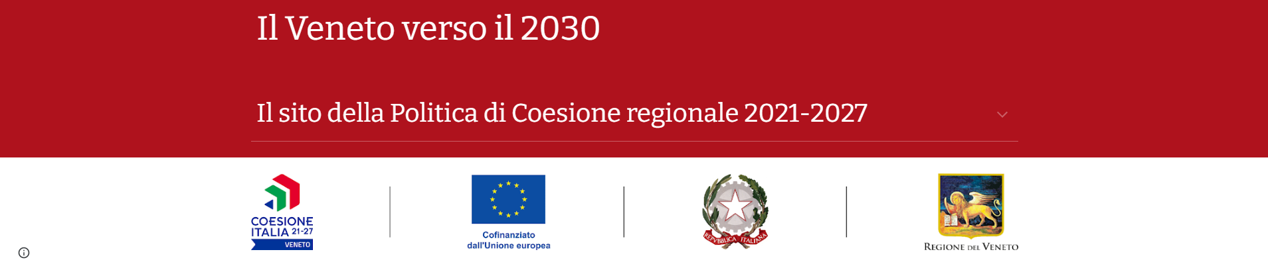

Veneto region Cohesion Policy 2021-2027 website portal
“Verso il Veneto 2030” home page
https://programmazione-ue-2021-2027.regione.veneto.it/
Sviluppo Urbano Sostenibile https://www.regione.veneto.it/web/programmi-comunitari/sviluppo-urbano-sostenibile-21-27

Slide 37

Contacts
area.politicheeconomichecapitaleumano@regione.veneto.it
programmazione-unitaria@regione.veneto.it
sus@regione.veneto.it

Slide 38
Questions from the audience?

Slide 39
EUI PEER REVIEW N° 6
04-05 DECEMBER 2024 BASSO PIAVE
Welcome and Practical details
Moderator: Adele Bucella, EUI Expert

Slide 40

Welcome !
EUI Peer Review: focus on supporting a small number of urban authorities to find solutions to common challenges linked to the design and implementation of their SUD strategies.
Cities Under Review:
  Basso Piave, Italy (HOST)
  Pilsen, Czechia
  Vukovar, Croatia
Peers: 15 peers from 9 countries (BG, EL, ES, HR, IT, PL, PT, SE, SI)
National Contact Points: 3 countries (BG, HR, LT)

Slide 41
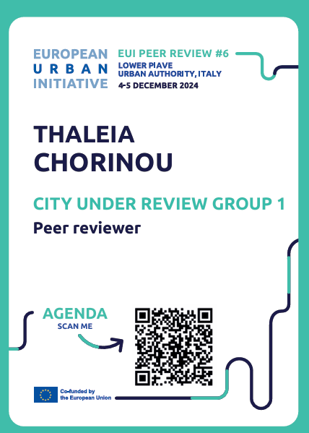
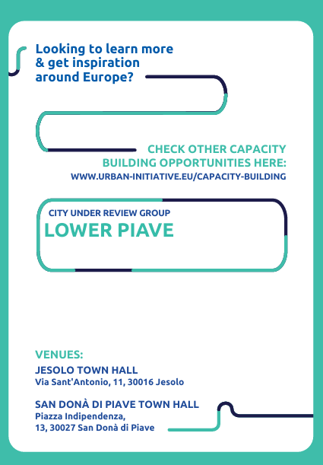
Badge information

Slide 42
Our Agenda
DAY 1

Slide 43
Agenda Day 1
08.30 – 09.00 Welcome and Registration 09.00 – 09.15 Welcome speeches 09.15 – 09.20 Understanding the implementation of Sustainable Urban Development strategies in Italy 09.20 – 09.35 Presenting SUD in the Veneto Region 09.35 – 09.45 Practical Details 09.45 – 10.00 Venetian Ice Breaker 10.00 – 10.30 Three Cities, Three Strategies 10.30 – 11.00 Coffee Break | 11.00 – 13.00 Peer Review Guiding Question N° 1 LUNCH 14.00 – 16.00 Interactive Session to address Guiding Question N° 2 – Monitoring 16.00 – 17.00 CUR Lessons from Day 1 and Networking 17.00 – 18.00 FREE TIME 18.00 – Bus to San Donà di Piave for local visit 20.00 Dinner in San Donà di Piave
Notes:
Agenda and presentation of EUI CB team

Slide 44
Learning and Action Grid

Slide 45
Learning and Action Grid
Tools to document lessons and ideas gained throughout the peer review​
On paper/ post its
CUR Record your learning, reflections and possible actions​
Peers recording your learning and suggestions for the CUR (including links to useful information)
Personal and Collective
Facilitators will give guidance in each session
Notes:
Agenda and presentation of EUI CB team

Slide 46
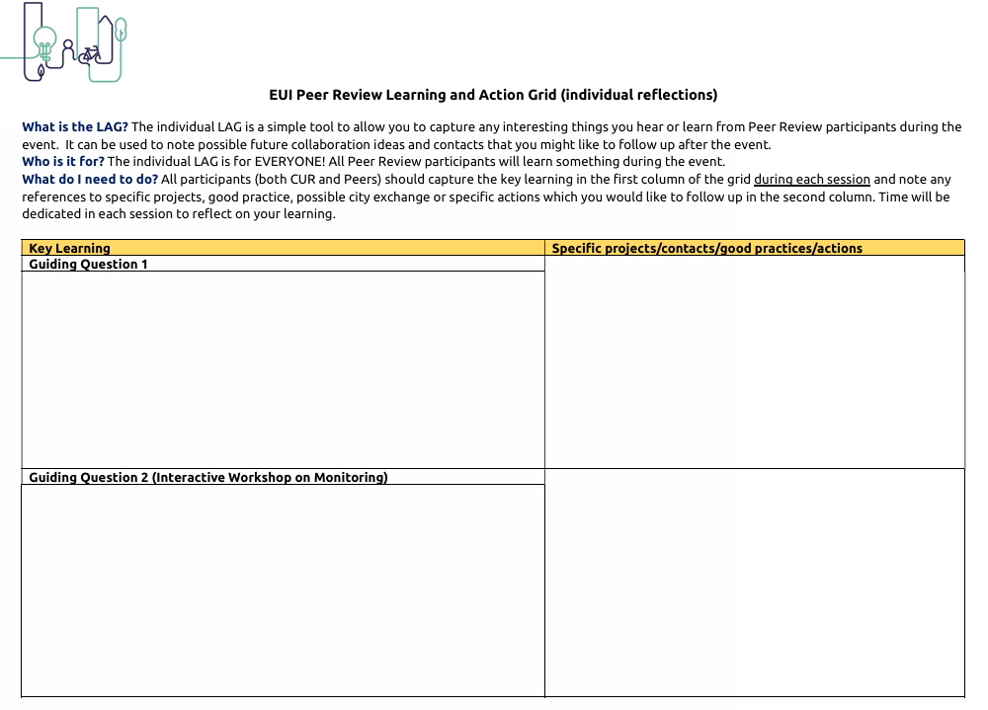
Learning and Action Grid for ALL
What is the LAG? A tool to capture learning.
Who is it for? EVERYONE!
What do I need to do? Fill it in with the help of your group experts
Notes:
Agenda and presentation of EUI CB team

Slide 47
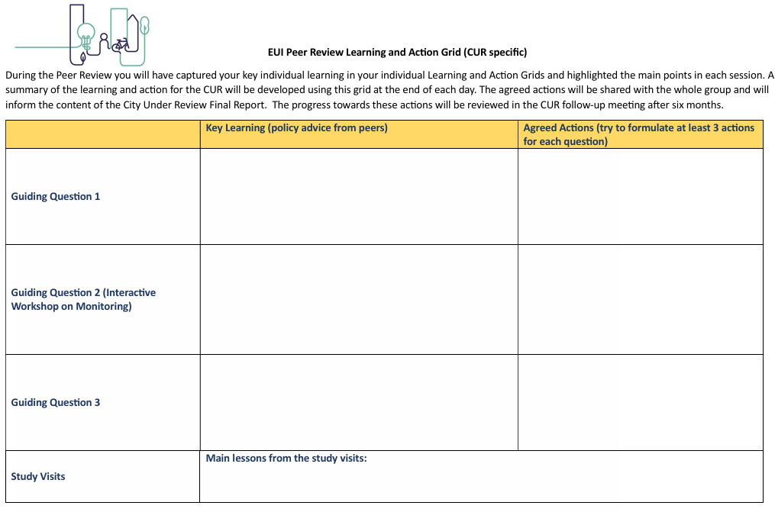
Learning and Action Grid for CUR
The CUR should use their LAG to help formulate ideas for action as a follow up to the peer review.
Notes:
Agenda and presentation of EUI CB team

Slide 48
A Venetian
Ice-breaker
Moderated by
Eddy Adams EUI Expert

Slide 49

ACTIVITY INSTRUCTIONS
National map
Everyone has a Venice icon card provided at registration this morning
One side has the icon image, the other side some questions
Step 1: Find your icon group with the same image
Step 2: Spend a few minutes together answering the questions in your group
Strategy map
Image by Eddy Adams

Slide 50

Question 3
LET’S GET STARTED!!

Slide 51
EUI PEER REVIEW N° 6
04-05 DECEMBER 2024 BASSO PIAVE
Three cities, three Strategies
Moderators: Martijn de Bruijn, Sally Kneeshaw and Eurico Neves EUI Experts

Slide 52
Vukovar

Slide 53
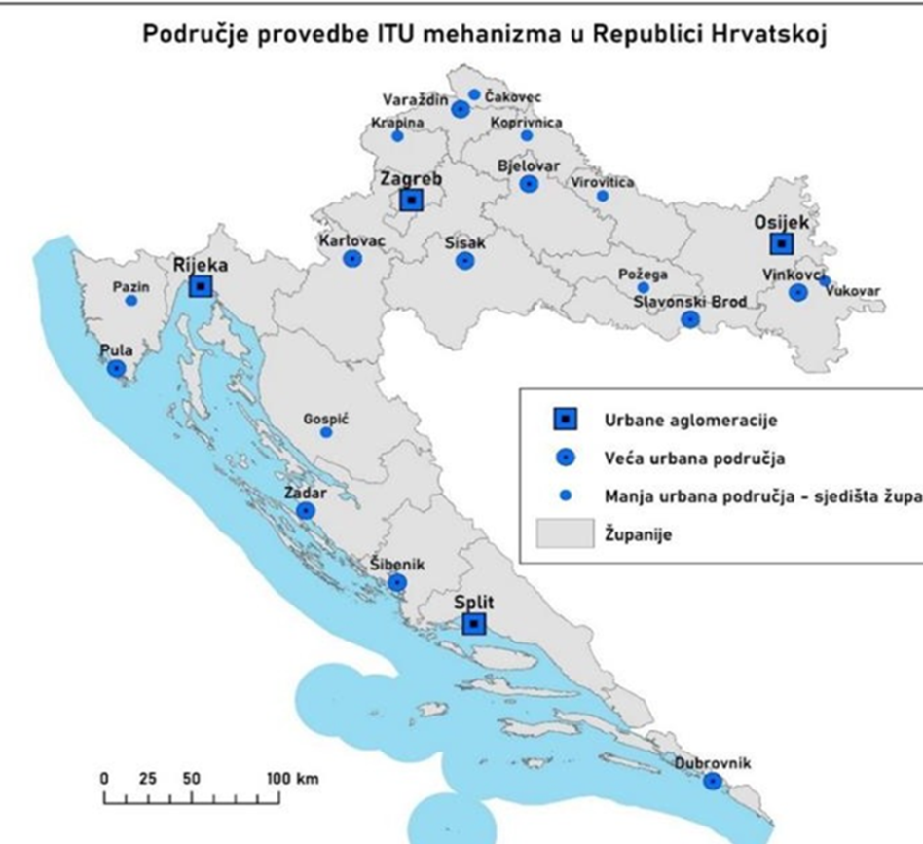
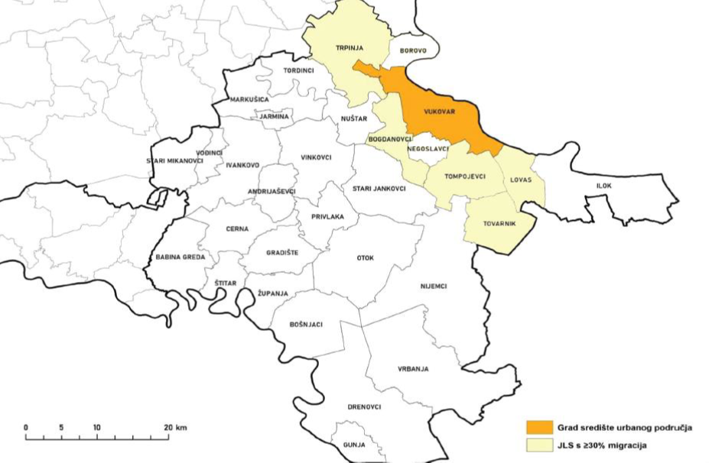
Strategy of the Urban area Vukovar
National map
Sustainable Urban Development Strategy for Urban area Vukovar 2021-2027.
Territorial delivery mechanism: Integrated territorial investment (ITI)
Main theme of the strategy: A common vision of the Urban Area of ​​Vukovar to establish a new direction of development and become a connected area of ​​new opportunities. Connection and cooperation of stakeholders in all areas, as a basis for solving common development problems and social challenges towards a key to achieve integrated and complete development of all components of the Urban area.
Strategic context: The Urban area Vukovar consists of City of Vukovar as the centre of the Urban Area and municipalitites of Trpinja, Bogdanovci, Lovas, Tompojevci and Tovarnik.
Strategy map

Slide 54
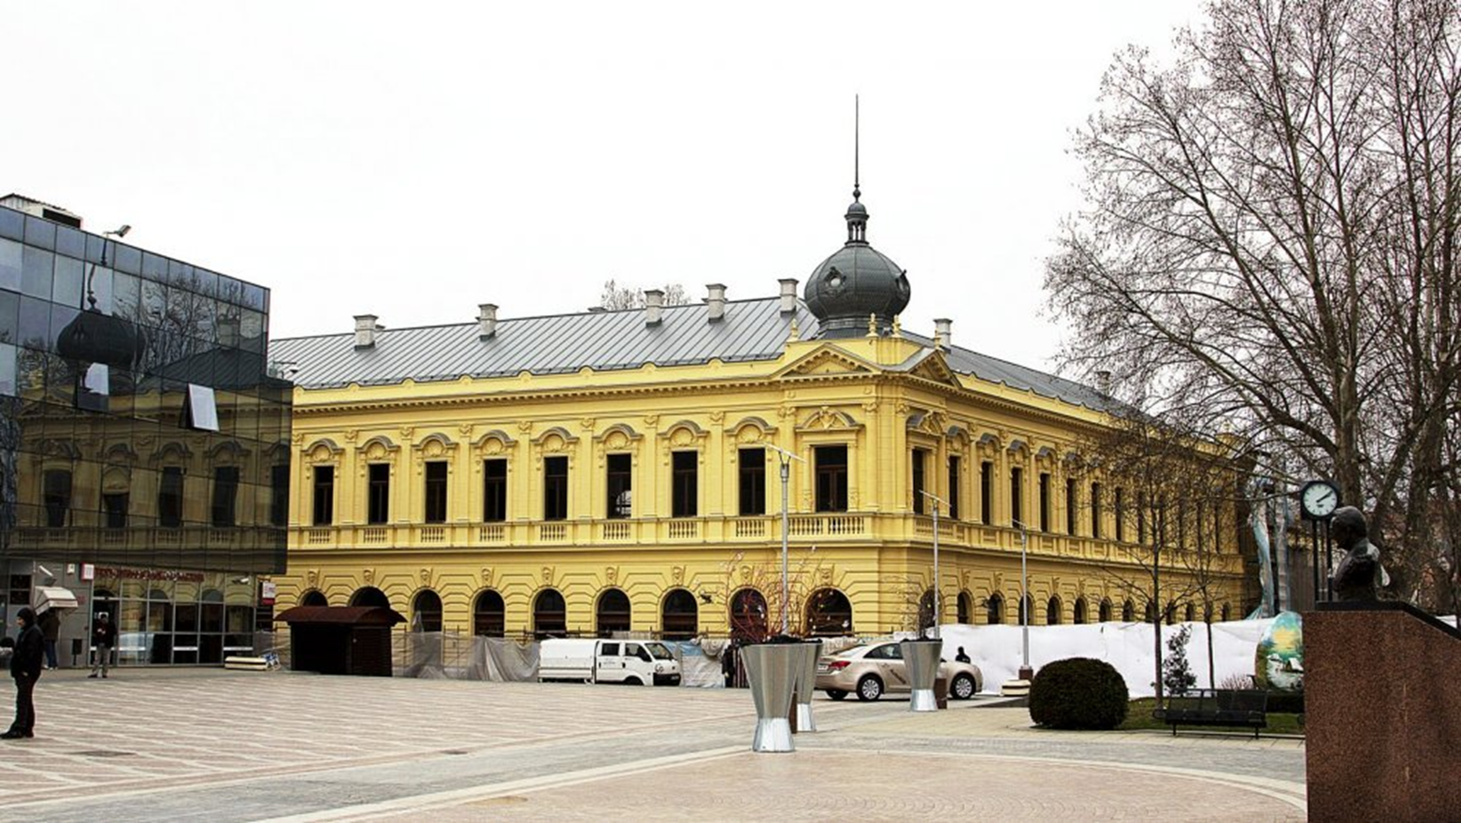
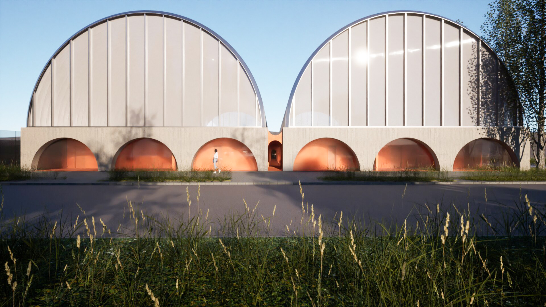
Strategy of the Urban area Vukovar
National map
Governance:
The Coordination council is the body responsible for coordinating the creation, modification and/or addition, adoption, implementation, and monitoring of the implementation of the urban area development strategy. It consists of mayors and heads of all cities and municipalities that are part of the urban area, or their deputies.
Partnership council of Urban area Vukovar has an exclusively advisory role, membership consists of LGU’s that make up the urban area, public bodies whose participation is significant for the development of the urban area – education institutions, economic and social partners, civil society, Vukovar development agency.
Stage of development:
The strategy design started in January 2022 and was adopted in January 2024. It covers the time period 2021-2027.
Agreement on the implementation of integrated territorial investments signed with the Ministry of Regional Development in December 2023 and currently in the active implementation stage.
Steps for the evaluation during implementation is about to start (public procurement)

Slide 55
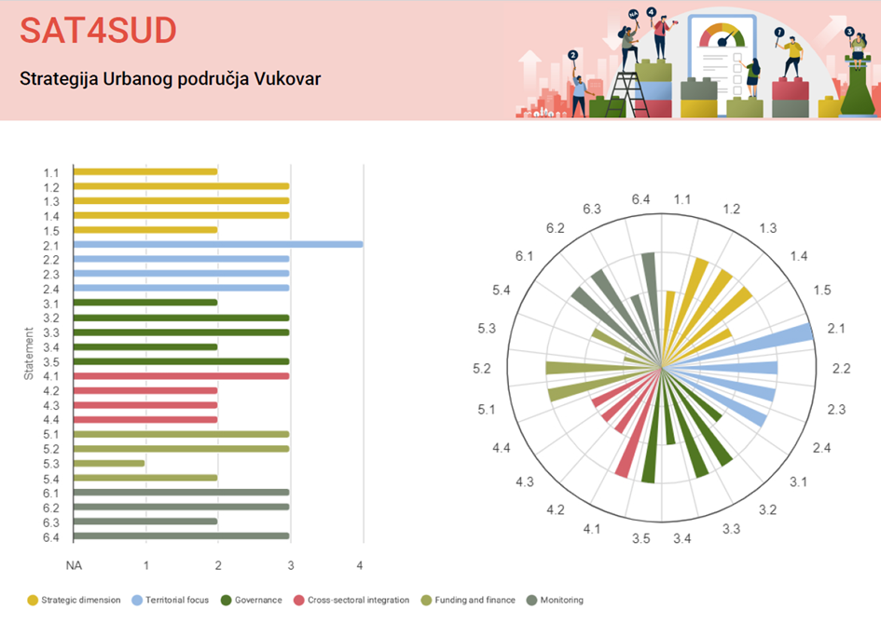
Strategy of the Urban area Vukovar
SAT4SUD Results
High scores: up to date analysis, links and synergies with national, regional and local agendas, strategy area clearly identified, good coordination between LGU’s, EU funding resources mostly identified
Low scores: strategy objectives not aligned with operational programme, low capacity of local authority, low participation of citizens, cross-sectoral integration not addressed as expected, lack of innovative funding approaches, components for monitoring strategy not organized nor efficient.

Slide 56
Strategy of Urban Area Vukovar
The three questions we would like to discuss
Question 1
Question 2
Question 3
How to achieve cooperation between administrative departments when this is essential for a successful implementation of the strategy?
How to produce indicators that can monitor the multi-sectoral, intra-sectoral and territorial dimension of the strategy?
How to overcome narrow citizen participation in local government activities and keep them involved in future decision making?

Slide 57

Insert logo of urban authority
Question 3
EUI peer review
Basso Piave, 4-5 December 2024
City of Vukovar
Martina Prepunić, Stela Geršić and Antoaneta Šibalić
itu@vukovar.hr
Thank you!

Slide 58
Pilsen

Slide 59

Presentation of ITI Pilsen agglomeration strategy
Peer Meeting
EUI Peer Review #6 - Piave Urban Area, Italy
4-5 December 2024
City of Pilsen
Šárka Řechková, Martin Babuška

Slide 60
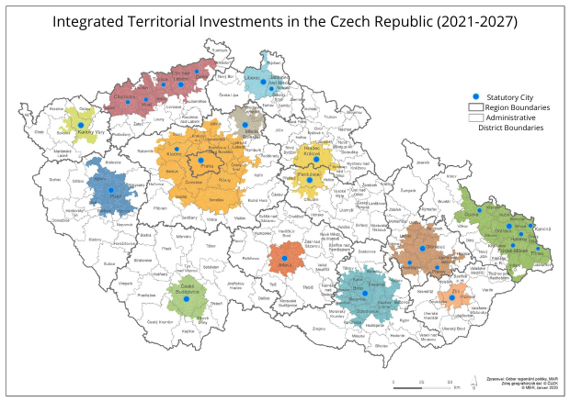
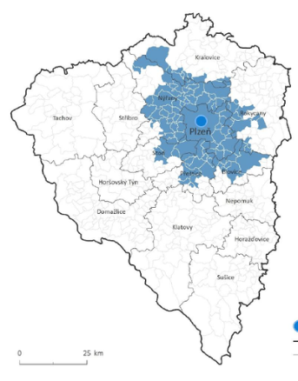
Pilsen agglomeration
National map
In the west of the Czech Republic, well connected with other parts of the CR and with Germany
107 municipalities and 1 strong regional centre – city of Pilsen
313 900 inhabitans in Pilsen agglomeration
Significant economic, cultural and industrial area
Pilsen agglomeration as an FUA is defined by Development Strategy of the CR (for implementation of ITI tool)
Czech legislation defines 13 cities in the CR, that are responsible for implementation of ITI, one of them is the City of Pilsen
Pilsen as a centre of IT and innovation-driven industries
Pilsen as a cultural hub with rich historical roots
Pilsen is the so-called carrier city of the Integrated Territorial Strategy
Strategy map

Slide 61

ITI Pilsen agglomeration strategy
Title of the strategy: Integrated Territorial Strategy of the Pilsen Agglomeration 2021-2027
Country: Czech Republic
Territorial focus: Pilsen Agglomeration (108 municipalities)
Targeted population: 313 900 (2021)
Funding type: ERDF: 70,08 million €, ESF+: 16,88 million €, CF: 68 million €
Amount: 154,96 million €
Policy objectives:
  P.O. 1 Innovation, Education, and Entrepreneurship
  P.O. 2 Environment
  P.O. 3 Mobility
  P.O. 4 Public Amenities
  P.O. 5 Sustainable Development of Towns and Villages

Slide 62
ITI Pilsen agglomeration strategy
Overall strategy was approved by City Council of Pilsen
The implementation of the projects has now begun
The funding for Pilsen Agglomeration is fully allocated among individual projects
Our next steps:
  To prepare a mandatory mid-term evaluation
  To consider potential modification to the conceptual aspects fo the Strategy

Slide 63
ITI Pilsen agglomeration strategy
The three questions we would like to discuss
Question 1
Question 2
Question 3
What key rules and goals should we prioritize for implementing the GreenDeal and SDGs, and how can we effectively support future projects, select preferred sectors for financing, and enhance financial coordination?
How can we effectively engage the Quintuple Helix, including authorities and citizens, in the implementation of new rules and goals within our strategy?
How can we enhance and optimize the monitoring process for the GreenDeal and SDGs, covering everything from indicator sets and project proposals to financial rules and the PDCA implementation?

Slide 64
Question 3
EUI peer review
Basso Piave, 4-5 December 2024
City of Pilsen
Šárka Řechková and Martin Babuška
rechkova@plzen.eu
Thank you!

Slide 65
Basso Piave

Slide 66
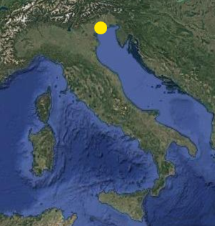
Strategy of the City of Piave
National map
Title of the strategy: Sustainable Urban Development Integrated Strategy – Urban Lower Piave
Country: Italy
Territorial focus: Functional Urban Area
Targeted population: 141.396
Funding type: ITI
Amount: 16,435,868.71 €
Policy objectives:
P.O. 1 (1.2, 1.3, 2.8)
P.O. 2 (2.7, 2.8)
P.O. 3 (2.8)
P.O. 4 (4.3)
P.O. 5 (1.3, 5.1)
Strategy map

Slide 67
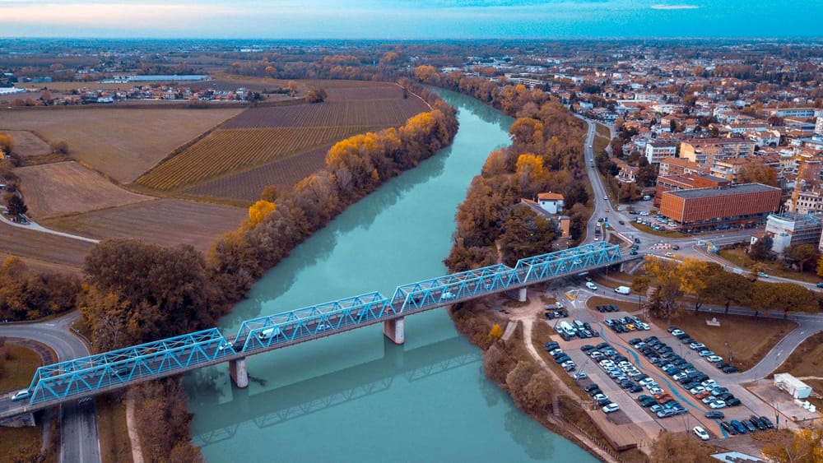
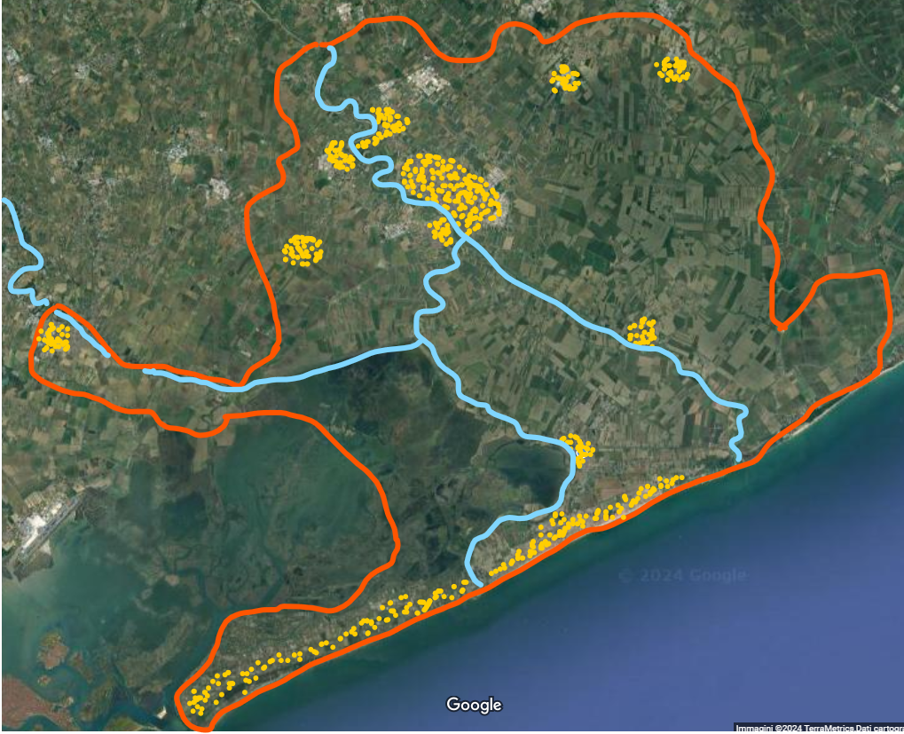
Strategy of the City ”Piave”
Territorial delivery mechanism: ITI
Main theme of the strategy: territorial cooperation, greener and more sustainable mobility
Strategic context: territory marked by alternate urban and rural landscape with strong urban polarities (internal and external – such as the city of Venice) and influence by the seasonality of touristic phenomena that interest part of the area during the summer months, affecting the local services and the economy. The fragmented institutional landscape seeks to invest in actions that improve the links between the several municipalities that constitutes the UA and provide new or improved services that benefit the most vulnerable groups within the local population.

Slide 68
Strategy of the City of Piave
SAT4SUD Results
Shortcomings:
3.4 – citizen engagement
4.3 – break the ‘silos’
5.2 – coordination with other funds
5.4 – use of innovative funding
6.2 – monitoring methodology
6.3 – types of data

Slide 69
Strategy of Piave
The three questions we would like to discuss
Question 1
Question 2
Question 3
How is it possible to boost an efficient governance integration and collaboration between the various local governments aiming to achieve a unitary effective impact?
How can monitoring be better integrated into a circular process of assessment in order to plan ahead for the implementation of further actions?
How can the 11 municipalities constituting the UA work together to attract further private and third-sector funding through other financial instruments?

Slide 70
Question 3
EUI peer review
Basso Piave, 4-5 December 2024
“Urban Lower Piave” Urban Authority
Nicola Contarin
nicola.contarin@comune.Jesolo.ve.it
Thank you!

Slide 71
Room Allocation
Basso Piave
Move to:
Room 1
(follow Eurico and Martina)
Pilsen
Move to:
Room 2
(follow Sally and Levente)
Vukovar
Move to:
Room 3
(follow Eddy and Martijn)

Slide 72
COFFEE BREAK

Slide 73
Breakout Room
Peer Review Session
Guiding Question N° 1

Slide 74
LUNCH BREAK

Slide 75
Interactive Session
Guiding Question N° 2

Slide 76
EUI PEER REVIEW N° 6
04-05 DECEMBER 2024 BASSO PIAVE
INTERACTIVE SESSION QUESTION 2
Moderators: Martijn de Bruijn and Sally Kneeshaw, EUI Experts

Slide 77
Setting the scene

Slide 78
Common CUR challenges
Dynamic session focused on three similar challenges across Cities Under Review (CUR).
Aims to provide:
overview of challenges related to monitoring
potential solutions through masterclass, experiences shared by peers and group discussions
identification of potentially effective solutions for CUR
opportunities for all CUR and peers to contribute/ learn across all CUR challenges
Notes:
Agenda and presentation of EUI CB team

Slide 79
Common Challenge method today
1400-1500 Masterclass
Inputs from Strathclyde University, City of Novo Mesto, City of Vantaa
1500-1600 Interactive discussion
Exercises- 2 rounds
Choose a different table each round
Mix with new colleagues
Capture ideas
Plenary session at end to feedback
Notes:
Agenda and presentation of EUI CB team

Slide 80
The 3 challenges…

Slide 81
Exploring CUR questions
BASSO PIAVE
PILSEN
VUKOVAR
How can monitoring be better integrated into a circular process of assessment in order to plan ahead for the implementation of further actions?
How can we enhance and optimize the monitoring process for the GreenDeal and SDGs, covering everything from indicator sets and project proposals to financial rules and the PDCA implementation?
How to produce indicators that can monitor the multi-sectoral, intra-sectoral and territorial dimension of the strategy?

Slide 82
QUESTIONS?

Slide 83
Masterclass

Slide 84

Monitoring of integrated territorial investments
EUI Peer Review
Martin Ferry, European Policies Research Centre (EPRC)
University of Strathclyde
Wednesday 4 December 2024

Slide 85
CONTENTS
Why is monitoring important?
What is needed?
  Selecting indicators
  Data collection & analysis
  Monitoring in the policy cycle
Key messages
Questions & answers

Slide 86
Why is monitoring important?
Vestibulum congue
efficiency & effectiveness
monitoring system
Vestibulum congue
visibility & capacity
Vestibulum congue
transparency & accountability

Slide 87
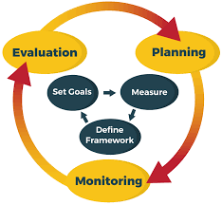
Efficiency & effectiveness
Generates data & knowledge to track progress, inform revisions
Helps evaluate results of measures contained in strategies

Slide 88

Transparency & accountability
Show that actions & results follow agreed objectives
Make data transparent to stakeholders: local communities

Slide 89
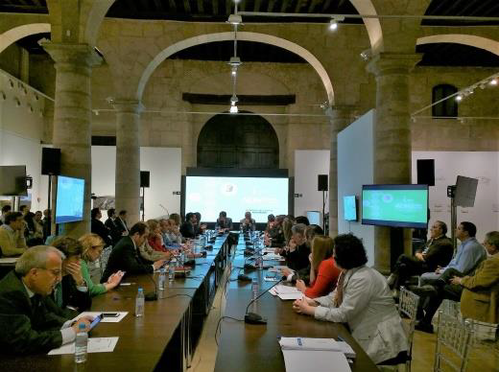
Visibility & capacity
Strengthened local mobilisation & ownership by demonstrating achievements
Local engagement in monitoring builds capacity & learning
EDUSI Murcia 2020 - Urban Rural links for Territorial Cohesion, Kasper van Hout Murcia City Hall

Slide 90

What is needed?

Slide 91

Selecting indicators

Slide 92
WHAT ARE INDICATORS?
Quantify data so that it can be measured and monitored
Determine whether change is taking place through ISTD
3 basic categories:
INPUT
OUTPUT
RESULT
What is being committed?
What does the action deliver?
What does success look like?

Slide 93

Input indicators - what is being committed?
Resources used to produce outputs & results
Can be expressed as:
            amount of expenditures
      workload input, time resources committed

Slide 94
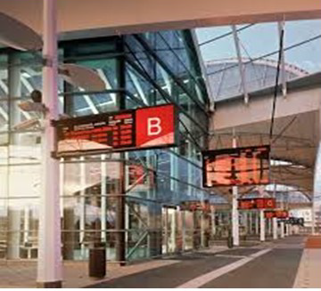

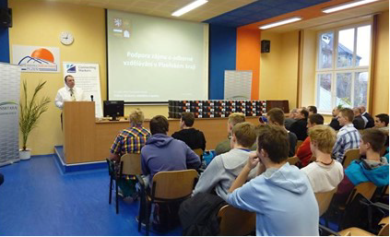
Output indicators - what is being delivered?
Concern specific deliverables
Measures what is produced or bought by the commitment of resources
Examples:
  km roads built
  urban wasteland rehabilitated
  no. trainees supported
  research and innovation infrastructure & equipment
Examples from the urban ITI Plzeň (Czechia)

Slide 95
Result indicators - what does success look like?
Measure results generated by supported projects (outputs)
Matches effects with reference to benefits for direct addressees
Require baseline value at the outset:
  from existing statistical or administrative data
  for smaller interventions, may need to new information (e.g. survey)
Should have a target value that refers to actual result aimed for

Slide 96
Capturing ‘integration’
Challenges: reconciling functional/administrative boundaries for indicators and data sources; measuring projects’ contribution to (multiple) OPs/funds as well as to the strategies themselves; measuring short/long term results; combining ‘hard’ results (e.g. of infrastructure investment with ‘soft’ (e.g. well-being, cohesion)
Risks: dominance of programme-level indicators complicates monitoring of achievements.
Responses:
Link (multiple) indicators to strategy’s logic of intervention and key objectives of strategy (e.g. linking business support and skills/training for development of deprived area).
Clearly align projects to strategy indicators at application stage (e.g. applicants state contribution to strategy objectives, links with other projects in the territory etc.)

Slide 97
QUALITY OF INDICATORS:
‘RACER’ PRINCIPLES
Relevant, i.e. closely linked to the objectives to be reached (Does the indicator really capture the change you described as your output/outcome?)
Accepted (e.g. by staff, relevant stakeholders). The role and responsibilities for the indicator need to be well defined
Credible for non-experts, unambiguous and easy to interpret (e.g. from the way the indicator is phrased, is it clear what exactly will be achieved? What exactly will be measured, in which geographical area, by what units?)
Easy to monitor (e.g. at low cost and with acceptable administrative burden. Do you have the expertise, time and staff to collect the required data?)
Robust against manipulation
Source: ‘Better Regulation’ 2021 Toolbox of the European Commission

Slide 98

2. Data collection & analysis

Slide 99
Key elements of system
Need for a robust system for generating, collecting and analysing monitoring data.
It can involve:
Direct data collection from participants/entities (e.g. questionnaires or surveys)
Data extracted from administrative registers
Recording and storing data. Data needs to be accurate and needs to be recorded correctly and in timely way (electronic database, spreadsheets etc.).
Proportionality: System proportionate to size and complexity

Slide 100
Designing a proportionate monitoring system
Scale and complexity of the monitoring system needs to be proportionate to the size of strategies and their operations.
Reduce the complexity and number of indicators. If each target has more than two or three indicators the feasibility, reliability and accountability of the indicators will be very complex
Develop a data collection plan. What data are needed? How will it be collected? Who will collect and report? How frequently? Costs and sources of financing?
Verify feasibility with national, regional, local administrations. Data availability? Indicator details (frequency, data time series, unit of analysis etc.)?
Be aware of the limited time (and resources) available for data collection. Beneficiaries may have short experience of project activities - can’t fully reflect on their value and effectiveness
Design monitoring questions that address beneficiaries experiences. Data collection (e.g. surveys or qualitative interviews) should present questions reflective of timing of the process, modest in expectations and fine-tuned to the beneficiaries’ actual experiences

Slide 101

3. How to embed monitoring in the policy cycle?

Slide 102
Monitoring & the policy cycle
Monitoring by itself does not improve performance
Must be integrated alongside other stages of strategy design and delivery:
Monitoring and evaluation. Monitoring feeds directly into evaluation: problems encountered in implementation, effectiveness in producing desired change.
Monitoring and communication. Monitoring reports should provide information on performance of the strategy to different target groups
Monitoring and strategy governance. Stakeholders need to discuss how findings will be used and what corrective actions should be taken to address any issues that monitoring reveals

Slide 103
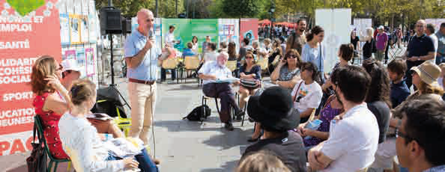
Monitoring & communication
Importance of ‘user-friendly’ and accessible monitoring outputs for different audiences
Regular monitoring reports provide an update on the strategy’s progress, feeding data into monitoring and evaluation processes at strategy and programme level
Oral presentations valuable in advertising the achievements of strategies at higher levels and, in particular, of strengthening ties with local communities through direct meetings
Use of different media: Other methods to reach wider audiences, particularly at the local level: press releases in local media, websites, online forums, blogs, tweets, discussions (online and live)

Slide 104
Involving local stakeholders in monitoring
Participation in deciding how progress should be defined and measured: collaboratively choosing indicators and metrics can make an intervention more realistic, relevant and responsive in its aims
Use of participatory data collection methods should be considered: working groups, community mapping or participatory ranking etc. ICT to open up methods for monitoring that incorporate participatory elements
May include capacity-building goal. Help local authorities and local stakeholders to build capacity on monitoring and reporting skills (e.g. training sessions, workshops).

Slide 105

Key messages

Slide 106
Selecting appropriate monitoring systems and indicator sets
Part of multi-level framework and should draw on existing monitoring resources, platforms at different levels.
But key indicators should relate directly to the objectives of the strategy itself
Capturing integration – across territories, sectors, programme/strategy levels, hard/soft, short/long term etc.

Slide 107
Developing an efficient system for data collection and analysis
Need for proportionality and flexibility, given variation in size in terms of population covered, thematic focus, budget, geographic scale and implementation approach
Use a limited number of key indicators with realistic possibilities of obtaining up-to-date data
Reflect on data-collection needs and capacity while defining the monitoring system. Identifying good indicators does not guarantee that they can be populated with adequate data

Slide 108
Embedding monitoring in development and delivery
Monitoring planned from the outset as an iterative process, designed and managed so that the updates coincide as much as possible with evaluation and feed into decision-making moments.
Think about how monitoring data will be used and who will use it: project specific knowledge to keep projects ‘on track’, operational knowledge to prompt administrative actions, strategic knowledge to inform decisions on whether to focus more on specific themes, reallocate resources etc..
Consider how this knowledge is communicated, produce simple information which is communicable and easily understood by both the provider and the user of the information.

Slide 109
Mobilising local actors
Co-create monitoring systems between strategy owners, local communities and citizens.
Consider capacity-building actions and instruments (such as training, toolkits, peer to peer exchanges, focus groups) to facilitate engagement of target stakeholders and beneficiaries in monitoring.
Plan monitoring milestones (e.g. annual reporting events, mid-term reviews) as opportunities to engage stakeholders in monitoring and modification of strategies.

Slide 110
Thank you for your attention!
martin.ferry@strath.ac.uk

Slide 111

Sustainable Monitoring
Meditation on pitfalls of Monitoring
Peter Geršič
Municipality of Novo mesto, Slovenia

Slide 112
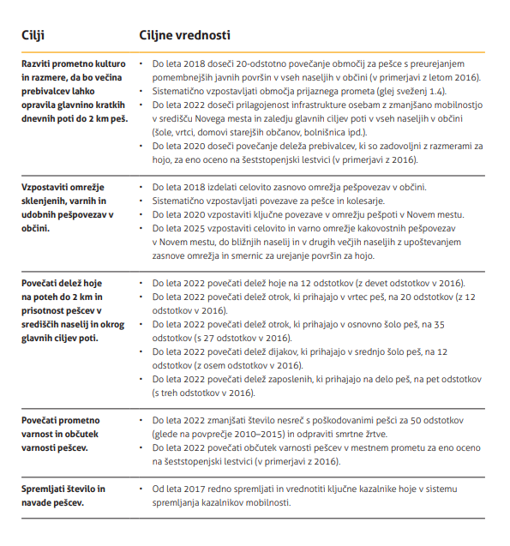
MONITORING SUSTAINABLE MOBILITY – BEFORE – 2016
Vague
Unspecific
Unmeasurable
Optimistic without causality

Slide 113
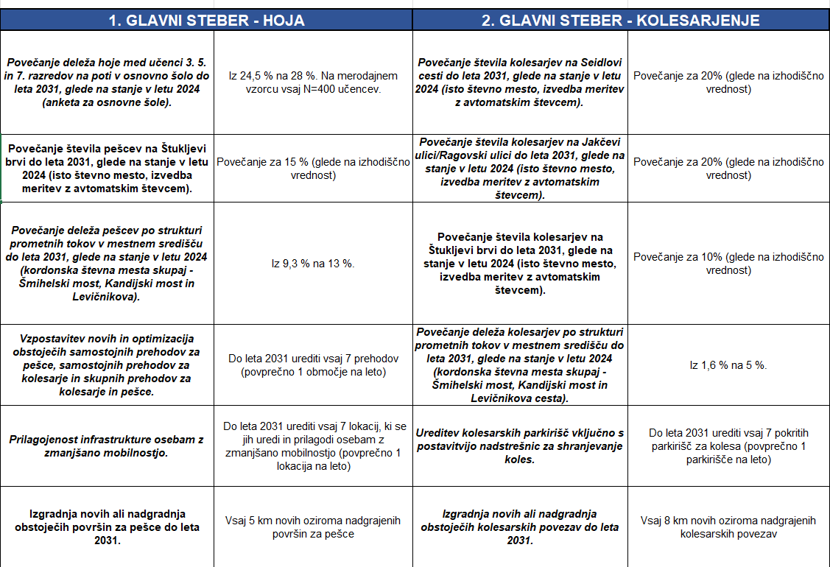
MONITORING SUSTAINABLE MOBILITY – AFTER – 2024
Set methodology
Comparable
Defined area
Specific with clear goal

Slide 114
KEEP IT SIMPLE
MAKE IT MANAGEABLE &
MEASUREABLE

Slide 115

KEEP IT SIMPLE, STUPID
Simple
Measurable
Aligned with goals
Really simple
Just enough specific
Stupid simple
Doable
Use digital solutions

Slide 116
EUI Peer Review
Municipality of Novo mesto
Peter Geršič
peter.gersic@novomesto.si
Thank you!

Slide 117
Advancing the sustainable development goals in Vantaa
Lotta Alajoki, Sustainability Specialist, City of Vantaa
4.12.2024

Slide 118

Our sustainable development work

Slide 119

Strategy integration: themes in the city strategy

Slide 120

Voluntary local review

Slide 121
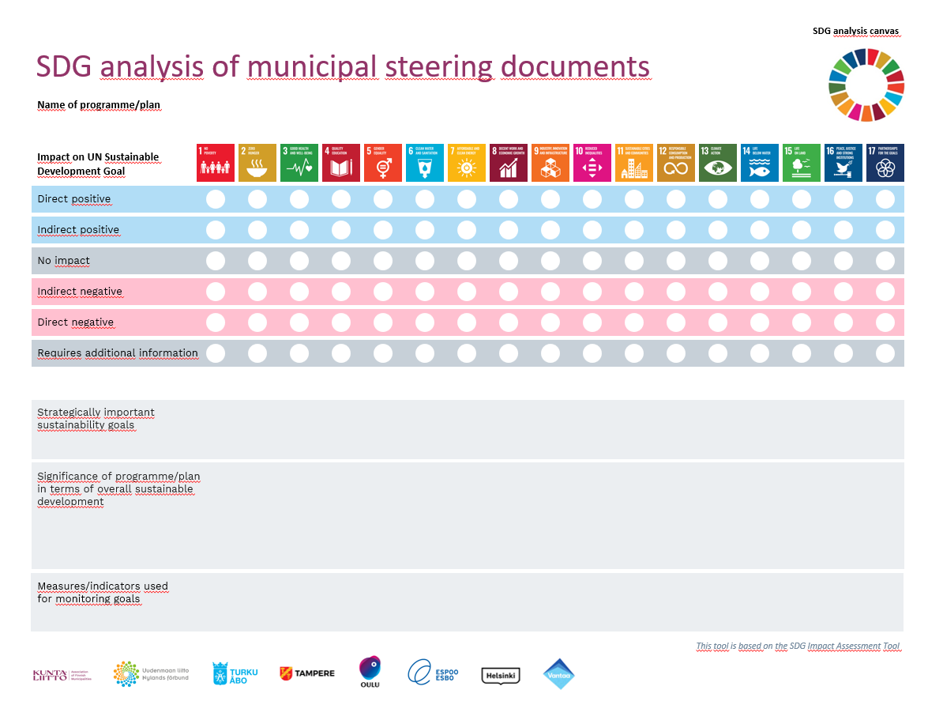
SDG analysis tool

Slide 122
Links
Vantaa voluntary local review 2023:
https://www.vantaa.fi/en/node/2441/sustainability-report-2023
Vantaa Roadmap to resource wisdom:
https://www.vantaa.fi/sites/default/files/document/Vantaa_Resurssiviisauden-tiekartta_EN_9_2022.pdf
SDG canvas and other tools created by the network of the 6 biggest cities in Finland (page in Finnish but tools available in English, scroll down the page to find them):
https://www.kuntaliitto.fi/johtaminen-ja-kehittaminen/sdg-tavoitteiden-strateginen-johtaminen-kaupungeissa-verkosto

Slide 123
Thank you. lotta.alajoki@vantaa.fi

Slide 124
QUESTIONS?

Slide 125
World Café Discussions

Slide 126
World café method today
4 tables are set up with flipchart paper, post its and pens
Each table will be hosted by EUI experts and staff
For each of the 2 rounds there needs to be 1 person from the CUR at their own table, to be able to answer contextual questions and listen to potential solutions.
All other participants can choose which table they want to go to each round.
In each round the table host and CUR repeat the challenge and moderate a conversation about the challenge and potential solutions.
Notes:
Agenda and presentation of EUI CB team

Slide 127
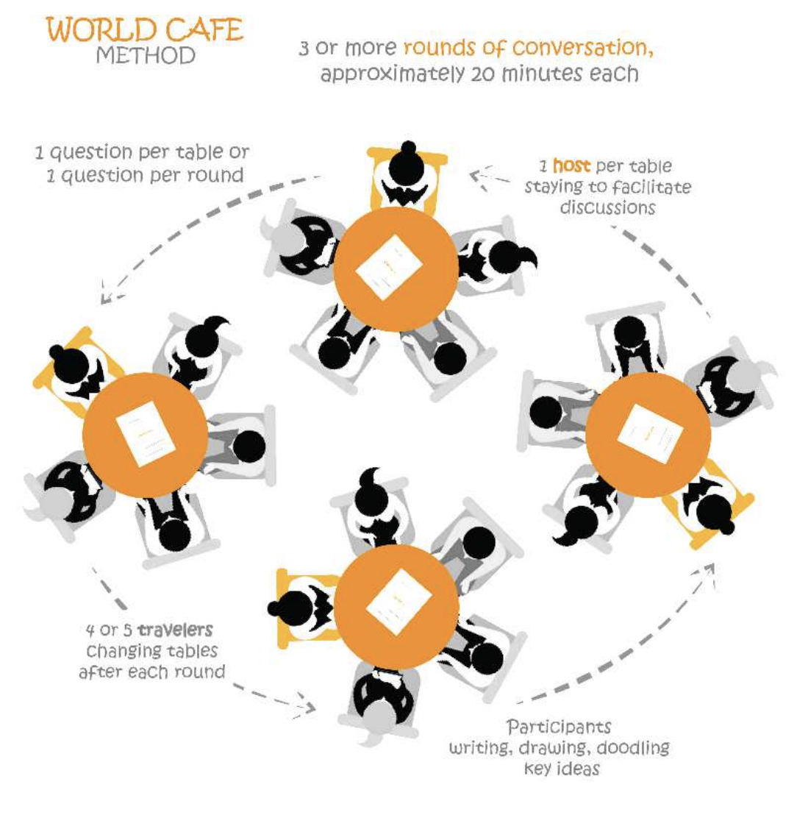
World café method
-
The World Café is an easy-to-use participative method to organise and facilitate meetings.
It helps creating a living network of collaborative dialogue and opening a space for the exchange of ideas.
Notes:
Agenda and presentation of EUI CB team

Slide 128
Pick your table!
Table 1 Feedback loops. What experiences can we share of ways to use monitoring, evaluation, learning to iterate, to inform future projects and bids, as opposed to purely reporting mechanisms? Facilitator – Eurico. Note Taker - Zoé
Table 2 SDGs -What experience can we share of connecting SDGs and associated indicators to ITI strategies? Facilitator- Levente. Note Taker - Magda
Table 3 Integration. Look at a pre-identified action from a real strategy and try to formulate indicators in a RACER way (Relevance, Acceptance, Credibility, Easiness and Robustness) that will support and measure different forms of integration (eg territorial/ cross sectoral). Facilitator – Eddy. Note Taker – Martijn
Table 4 SAT4SUD: This table will look at the monitoring questions in the SAT4SUD and do a hands-on Sat4SUD exercise. This would be especially suitable for peers not very experienced in monitoring. Facilitator – Martina. Note Taker - Paul

Slide 129
Common Session
Plenary feedback and main lessons

Slide 130
CUR Wrap Up and Networking

Slide 131
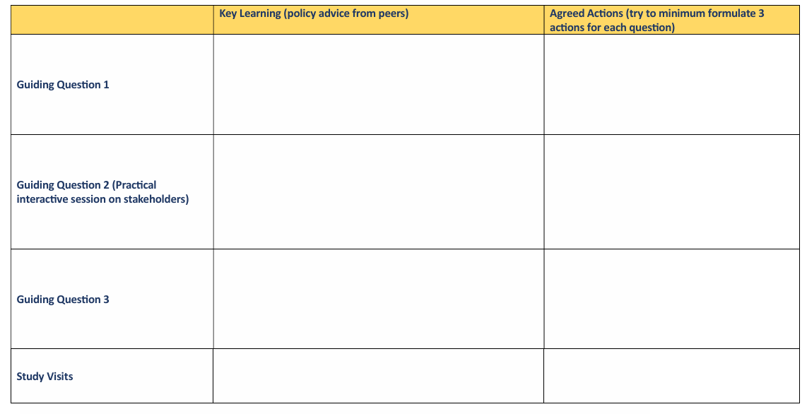
Wrap Up and Networking
CUR take time to work with their Peer Reviewers to complete the Learning and Action Grid for the sessions already completed at the end of Day 1.
FOCUS on recommendations and actions that you would like to explore in your city.
Agree in CUR group (without peer reviewers) which actions to include in the learning grid
Notes:
In part 2, call them sessions
The peers, in sesión 1.2, will be sharing experiences linked to the type of stakeholder (private sector, general public and municipalities) and point of dicsuccsion (gain trust, raise interest, bring on board). These peers Will stay in the table where you Will be working during part 2. These pithces, Will be just opening the discusiónwhich then, in part 2, can continue.
Key learnings here generated
When we finish this sesión, the CUR teams, Will have time to reflect on the key learnings from each talbe, and agree on their three actions
Eleni

Slide 132
Room Allocation
Basso Piave
Move to:
Room 1
(follow Eurico and Martina)
Pilsen
Move to:
Room 2
(follow Sally and Levente)
Vukovar
Move to:
Room 3
(follow Eddy and Martijn)

Slide 133
Emergency Contact Numbers
If you get lost or have a problem, you can call:
Magda – 0033 6 32 11 40 05
Adele – 0033 6 06 75 03 33

Slide 134
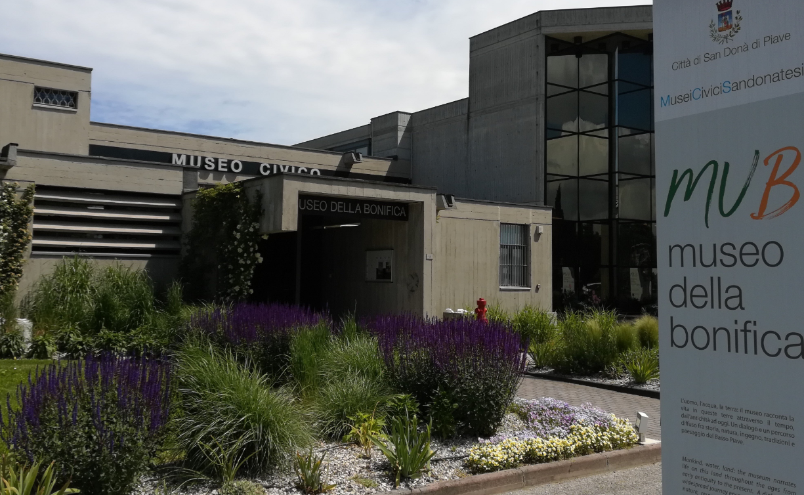
MEETING POINT:
Meet outside Hotel Adlon 18.00
VISIT:
Museo della Bonifica
DINNER: Hotel Ristorante Forte del 48, San Donà di Piave
Notes:
Martina kicks start this part, to indicate the main suggestions/recommendations as well as most common solutions, if any (5 minutes). Martina
Martina invites peers to present additional relevant ideas coming from the group discussions, or from their experience. Selected peers (e.g. from 2.1) can be asked in advance to be ready to participate, if needed (5/10 minutes).
Eleni asks CUR their thoughts on the recommended ideas, what can be done in practice for their realities, how they find the solutions, what is not feasible and why.
Martina closes the session

Slide 135
FREE TIME

